Slide 1


Figure 1
HMMER
ClustalO
Phylo Trees
NCBI/JGI
BLAST
Dataframe
Results
BUSCO
DIAMOND
Graphs
Primary
Literature

Slide 2
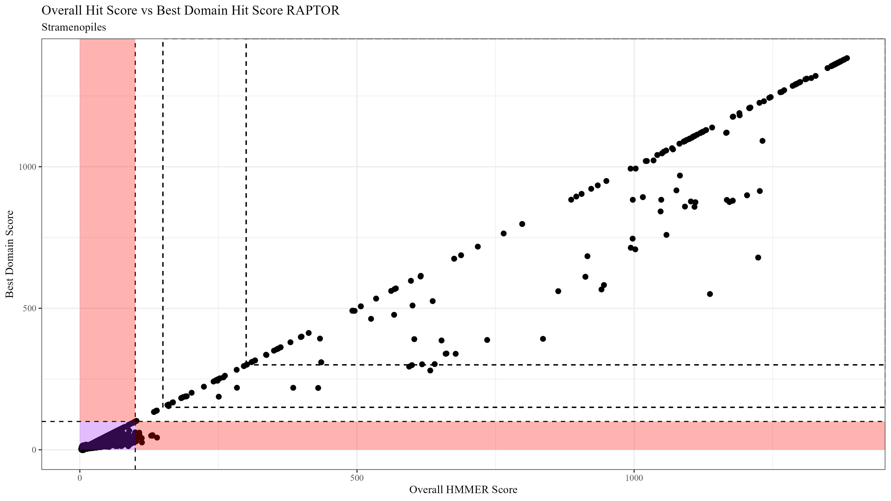
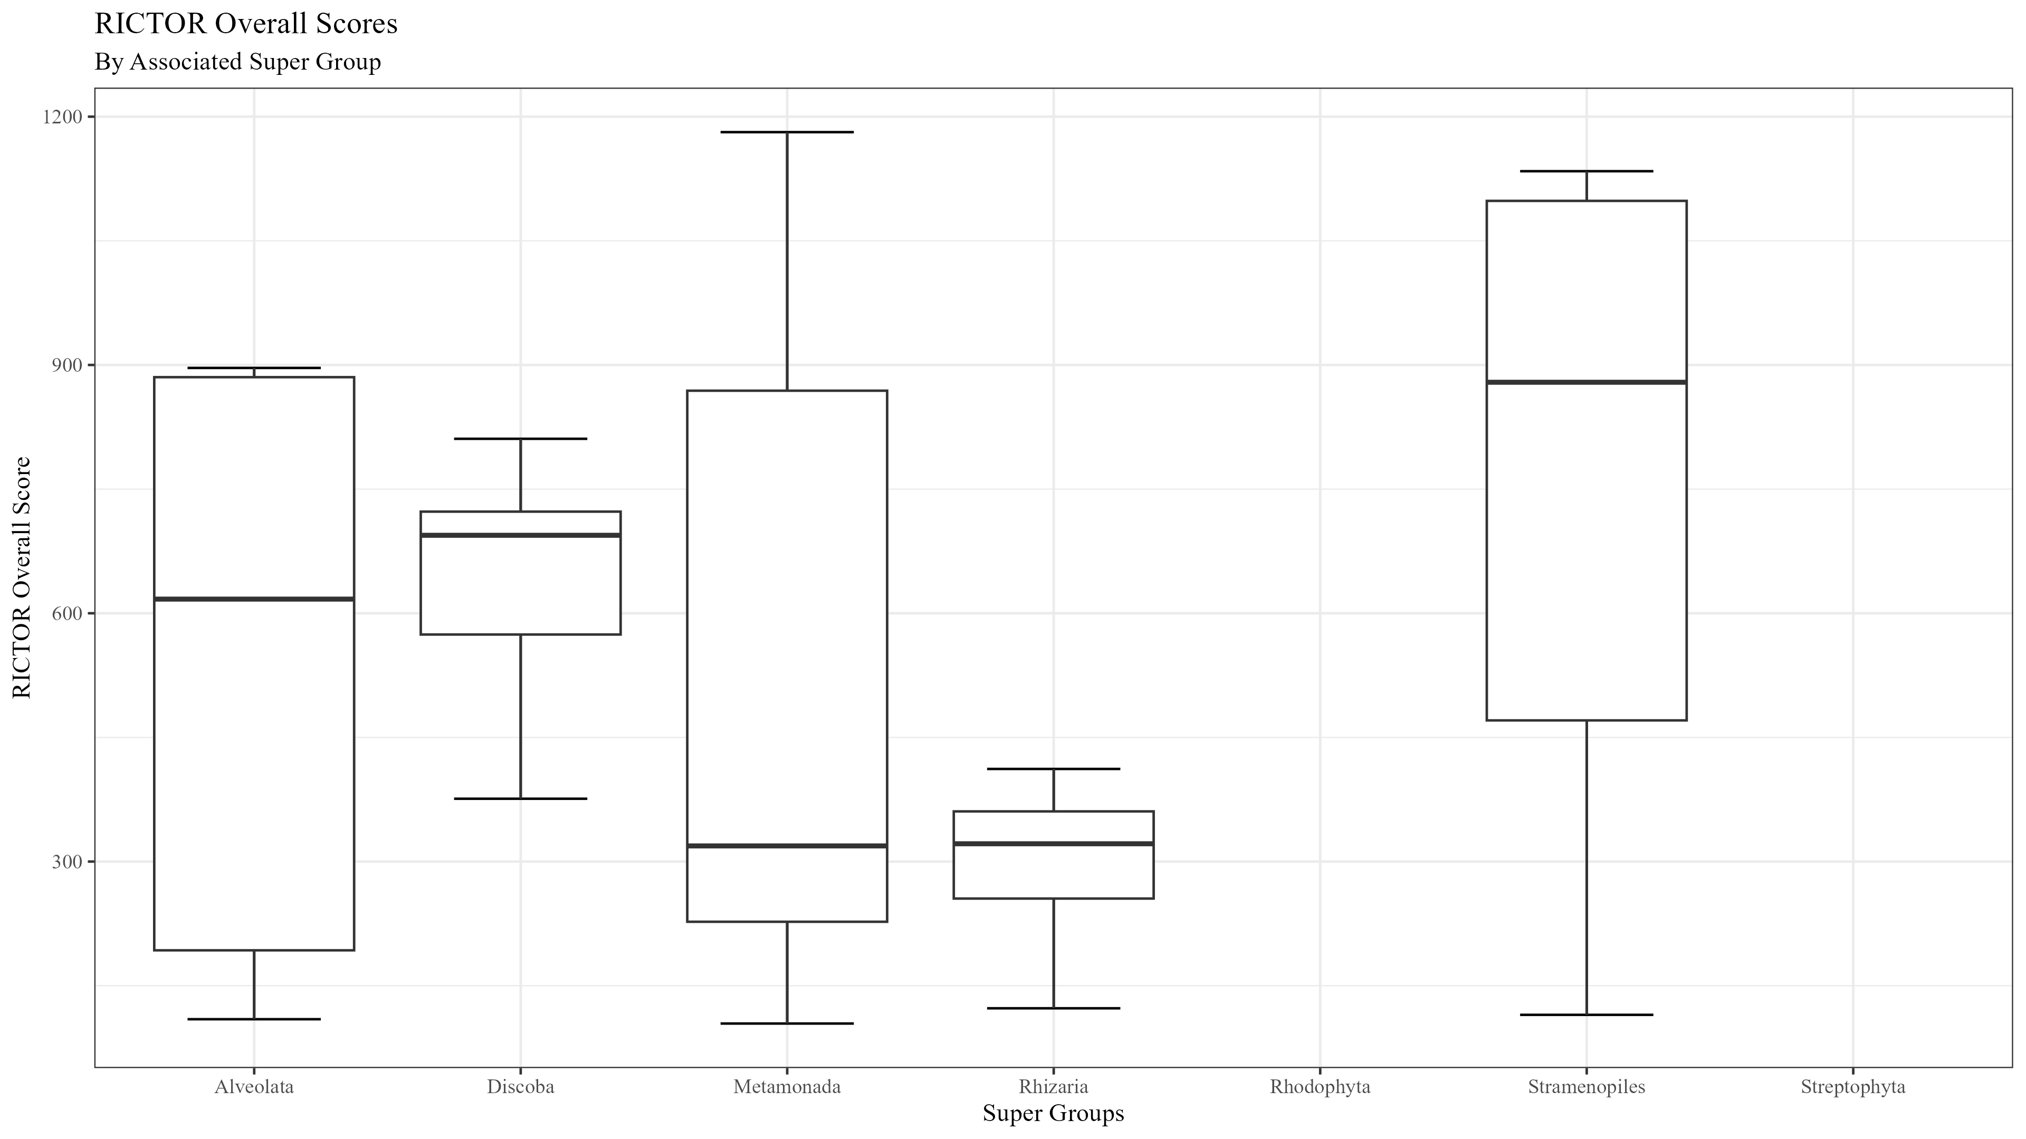
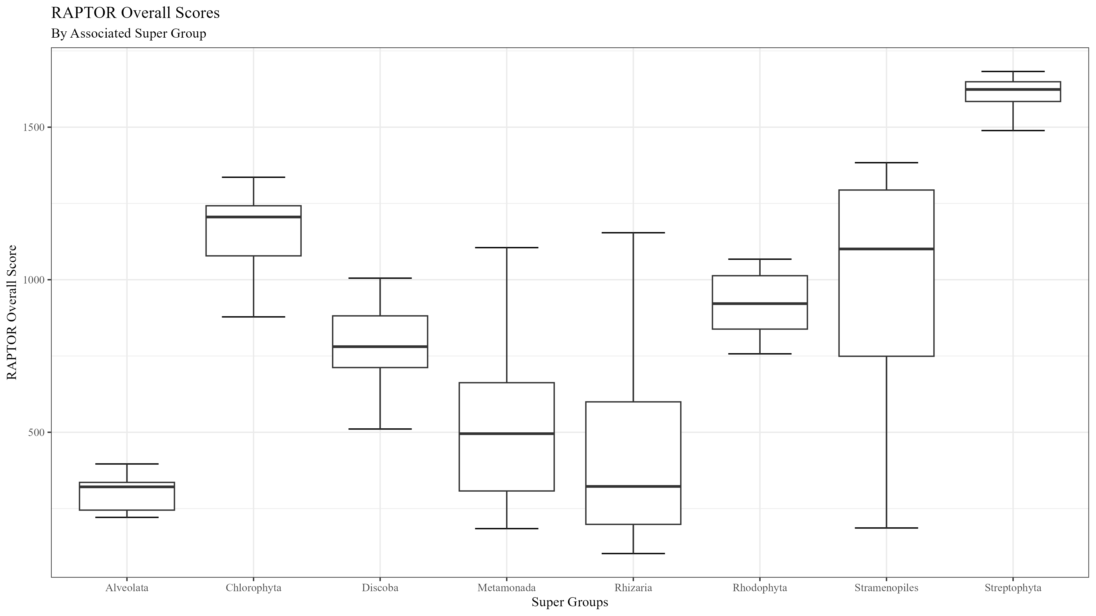
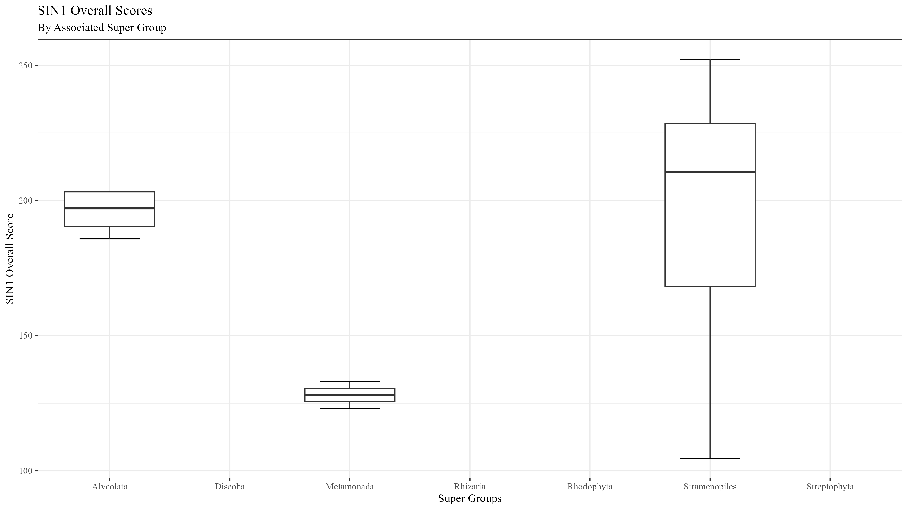
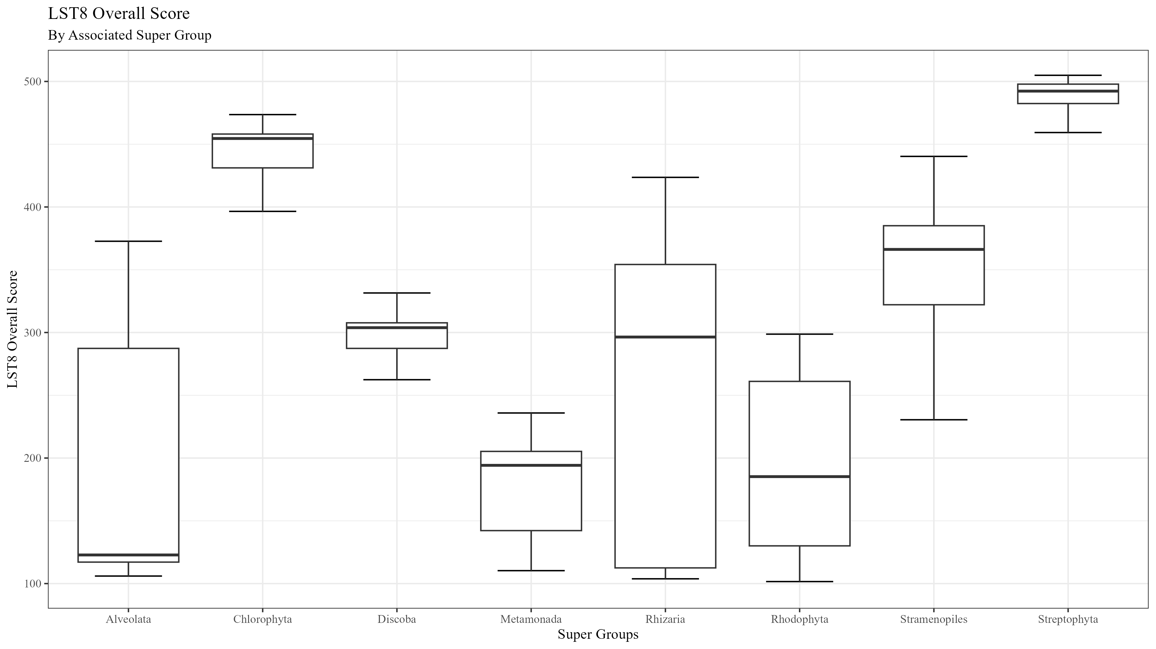

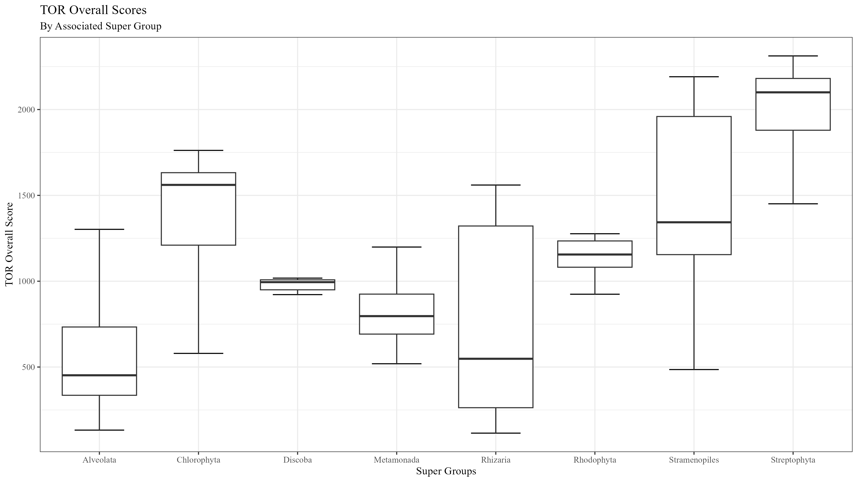
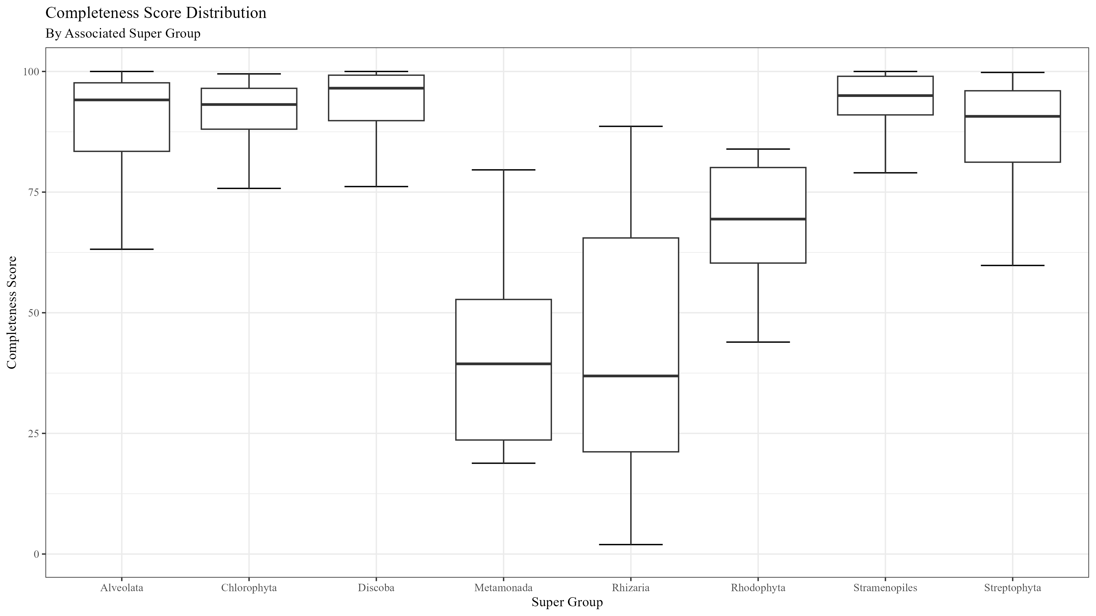
Figure 2

Slide 3
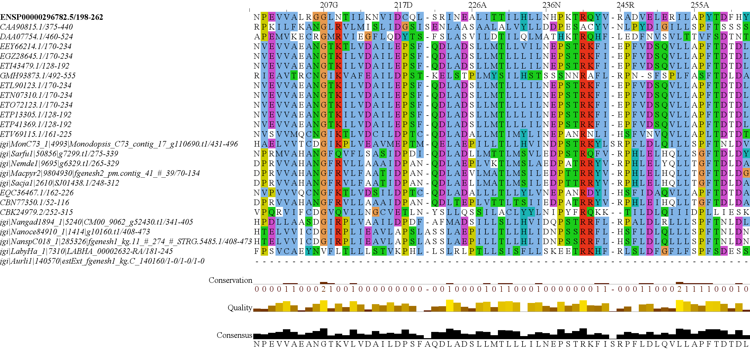
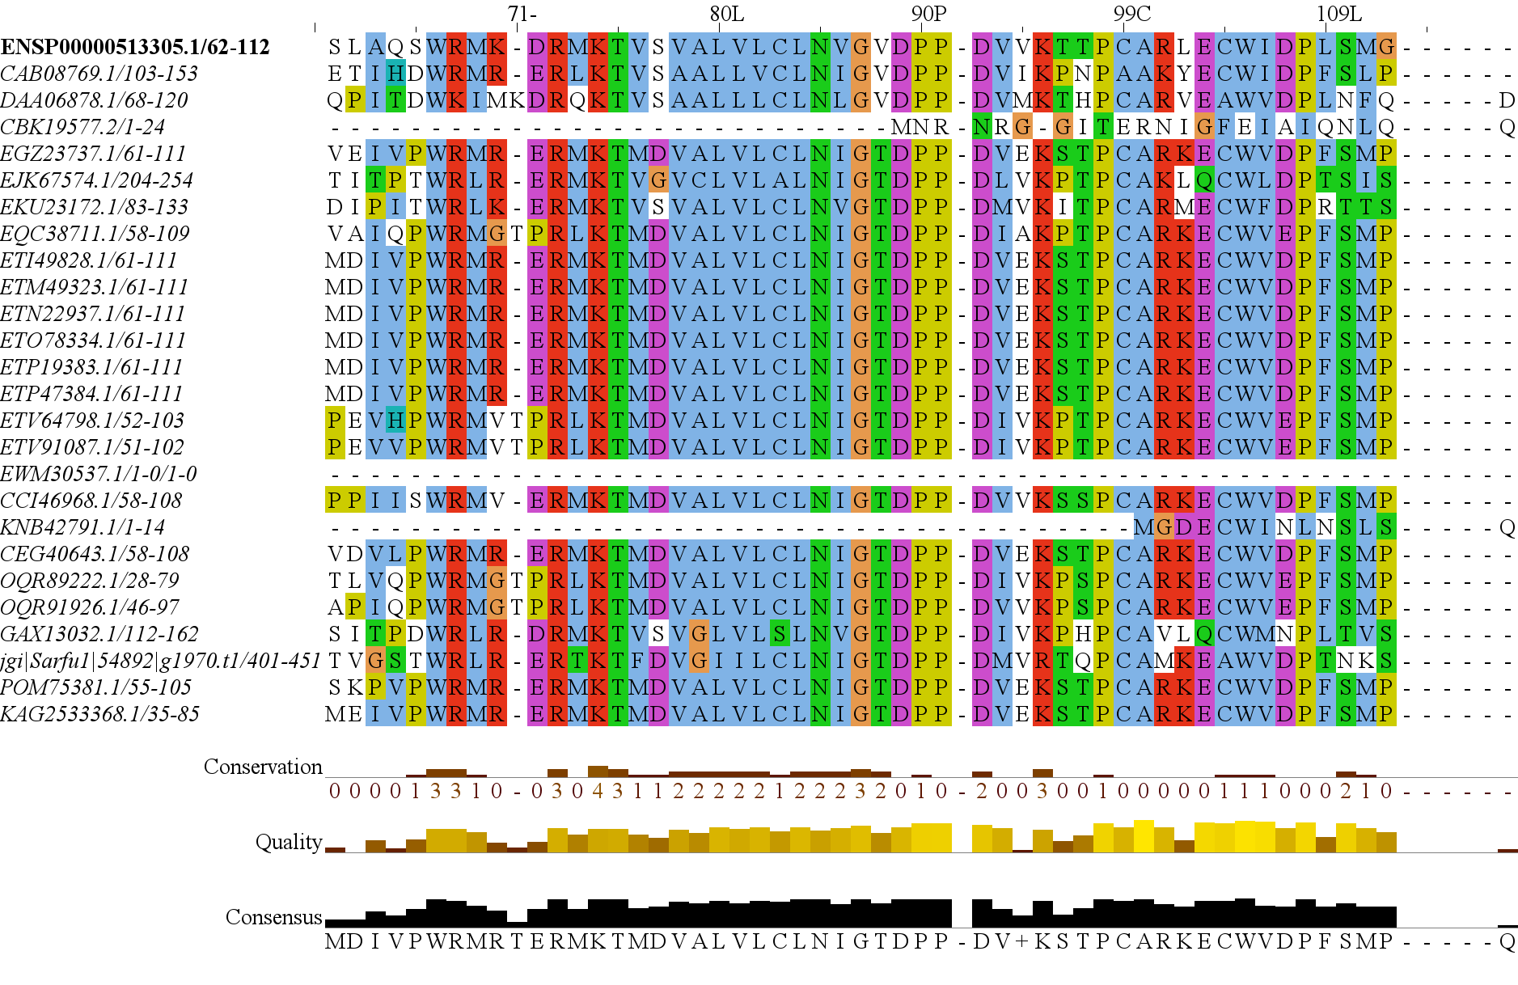
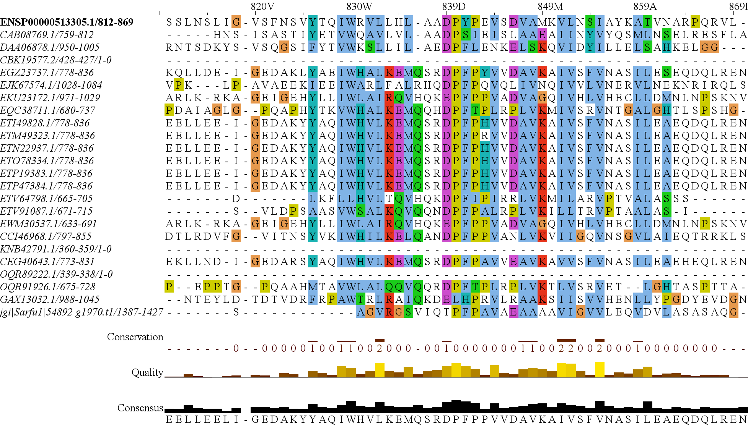
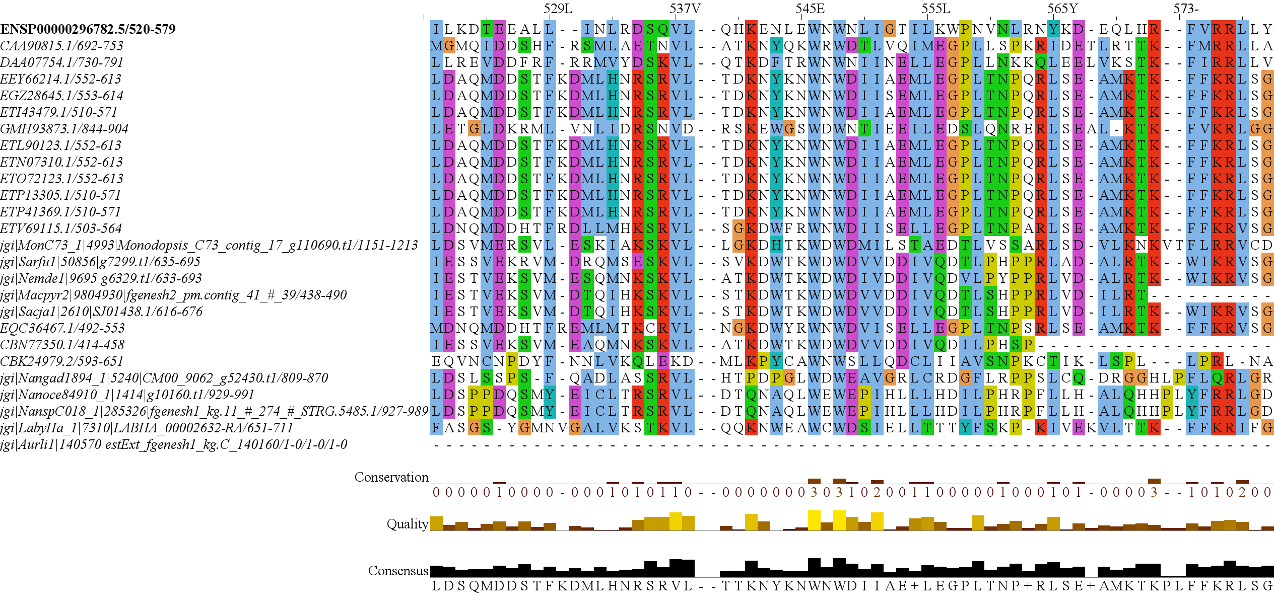
Figure 3
RICTOR
RAPTOR
N
N
RICTORN
RAPTORN
Reference
Reference
High
RICTORM
ARM
High
Medium
RasGEF
HEAT
Low
Medium
Dom5
ARM
Reference
Reference
RICTOR
Phosphorylation
WD-40
High
High
Medium
Medium
Low
C
C

Slide 4
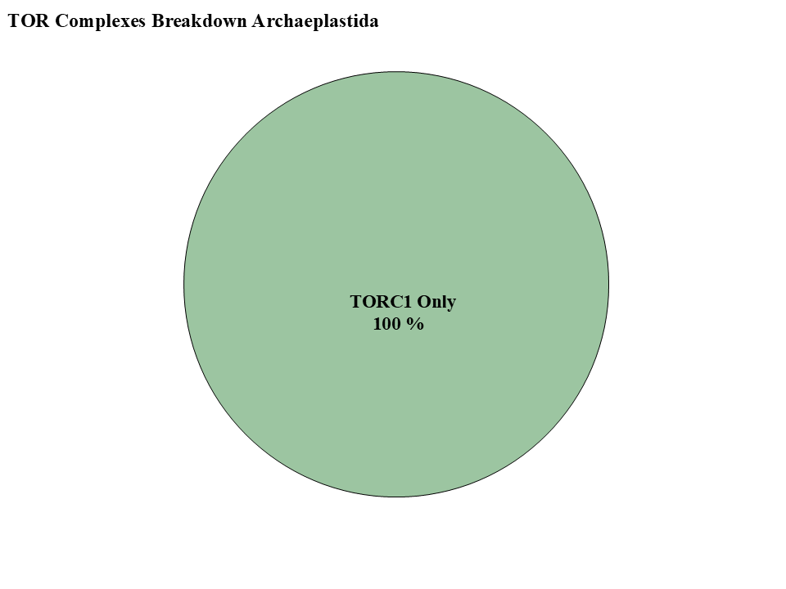
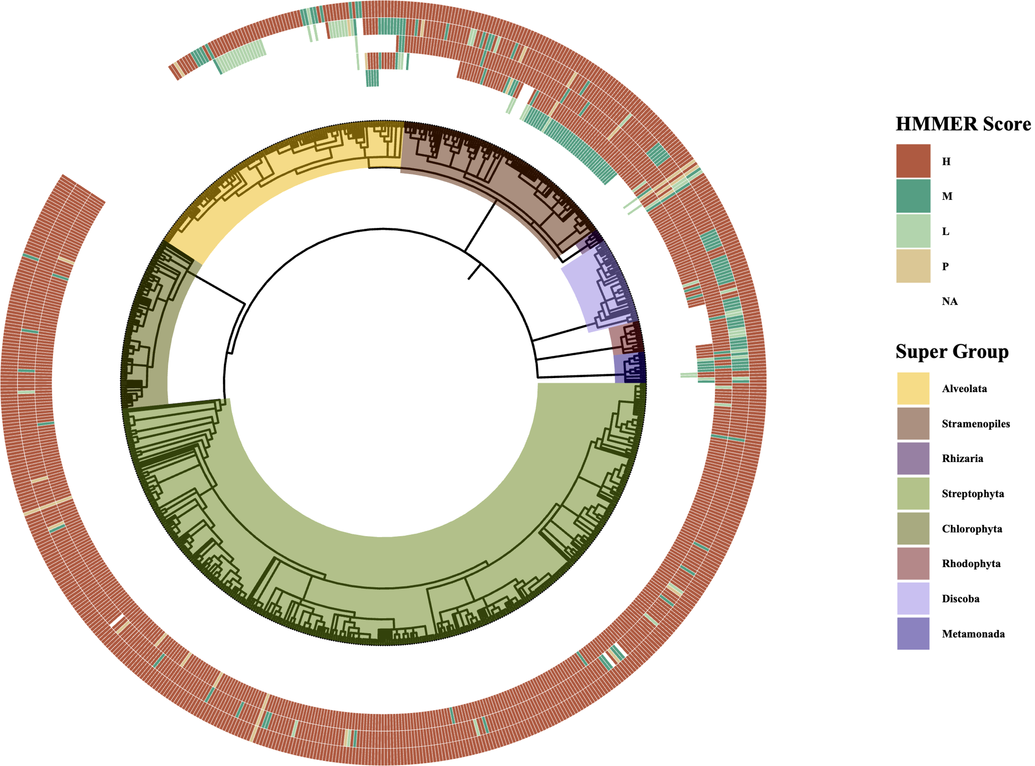
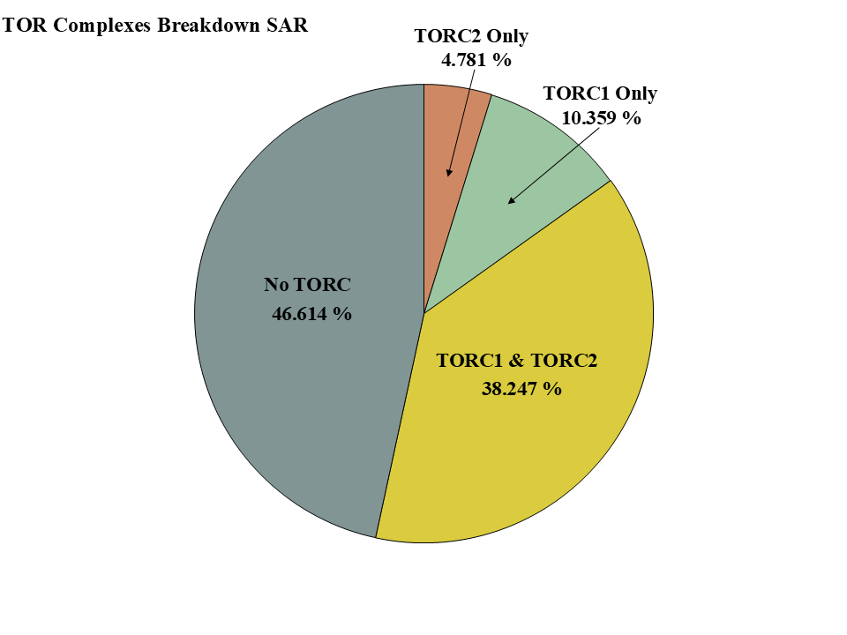
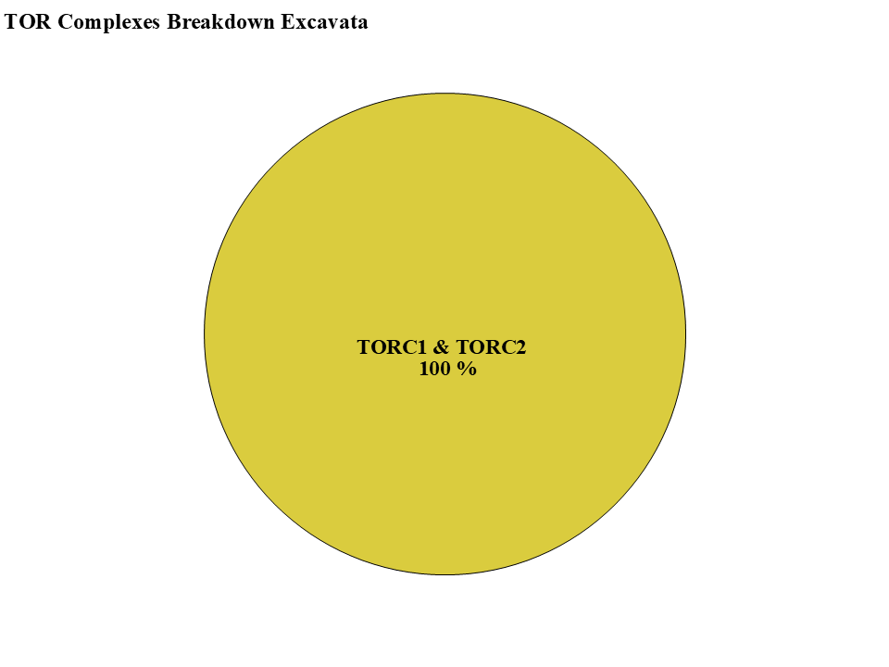
Figure 4
-TOR-
-LST8-
-RAPTOR-
-RICTOR-
-SIN1-

Slide 5
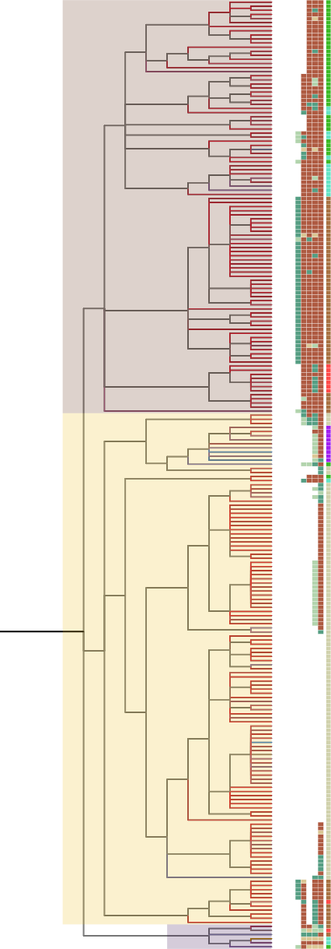
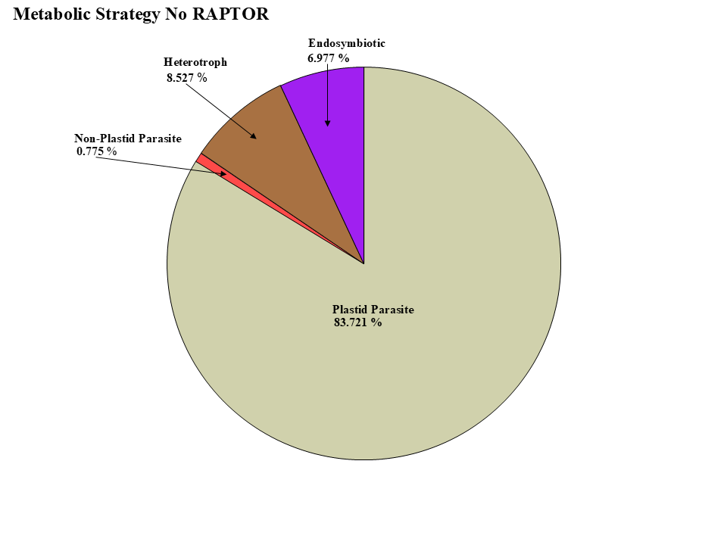
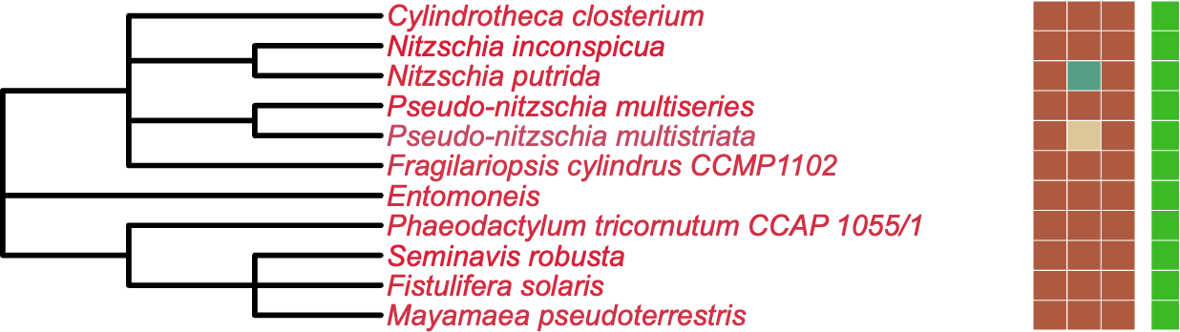
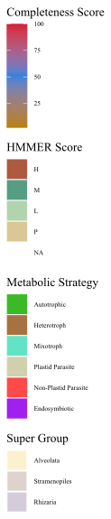
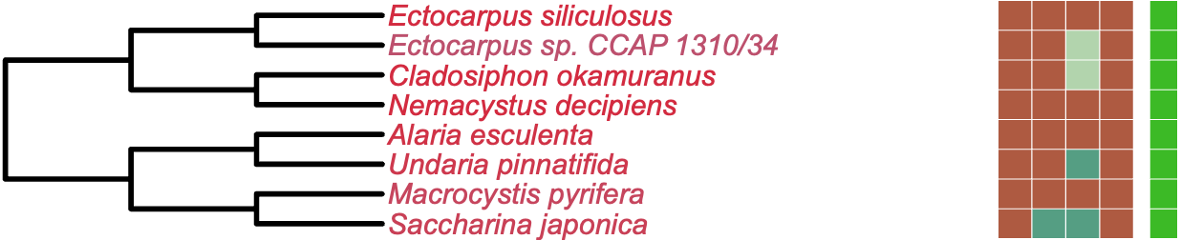
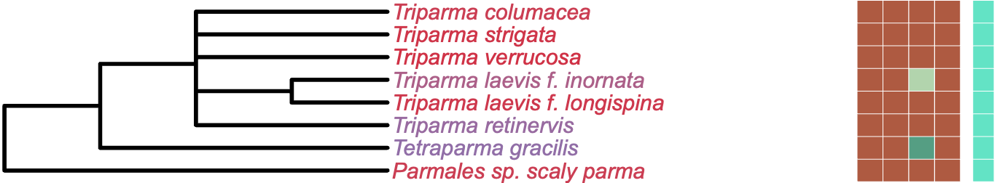
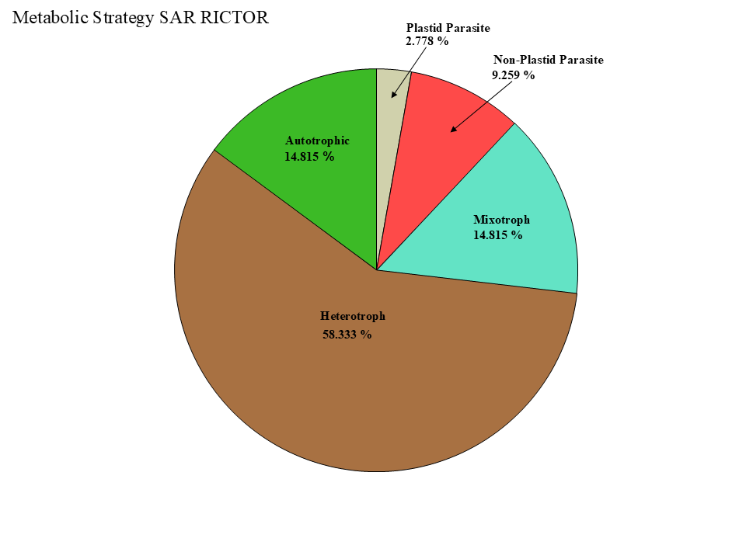
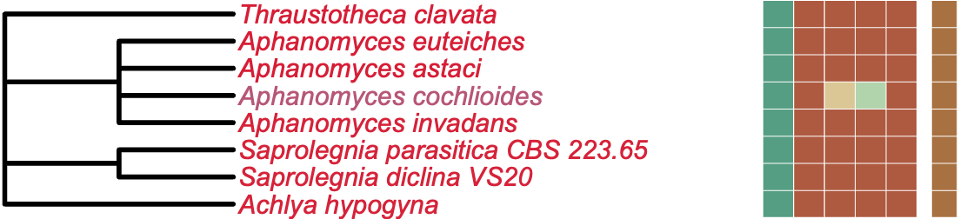
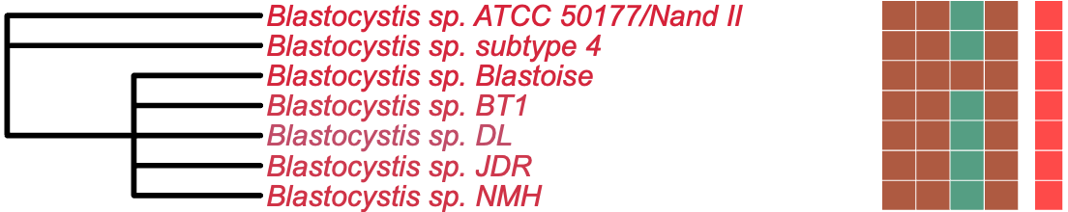
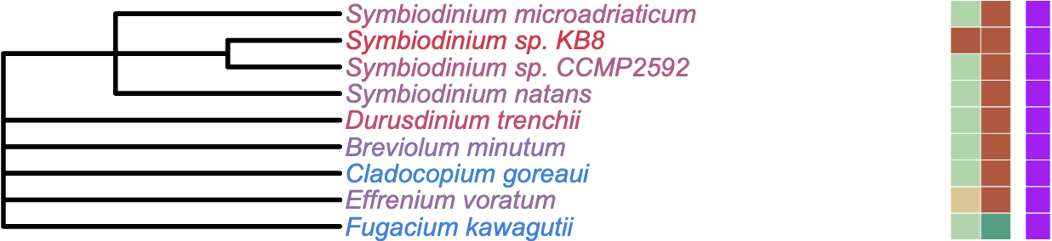
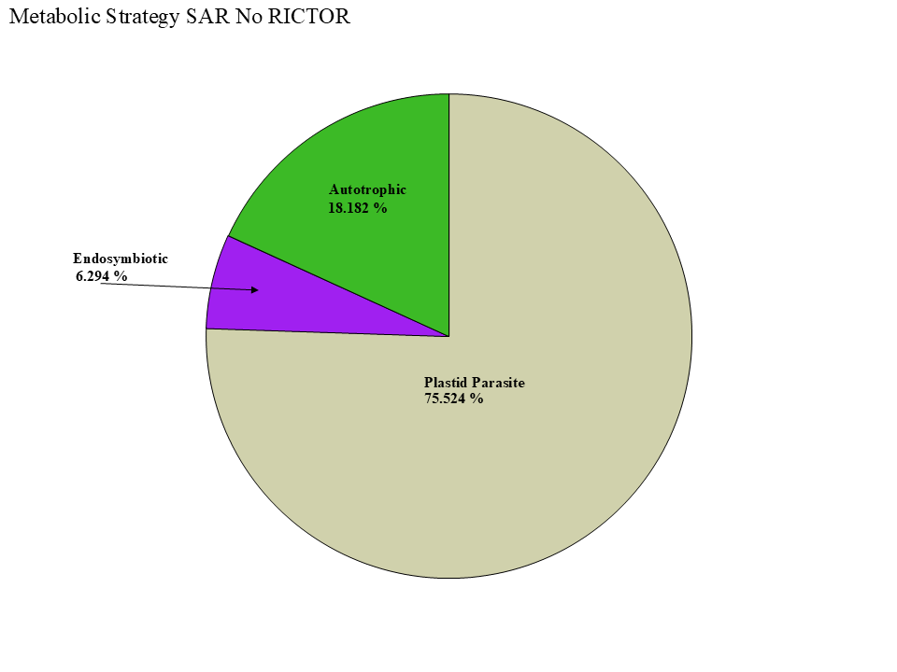
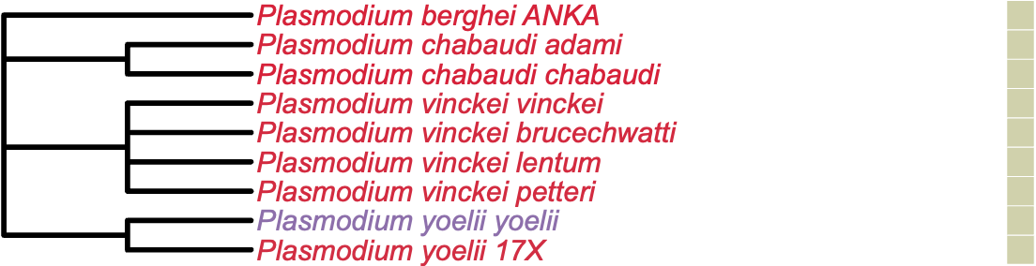
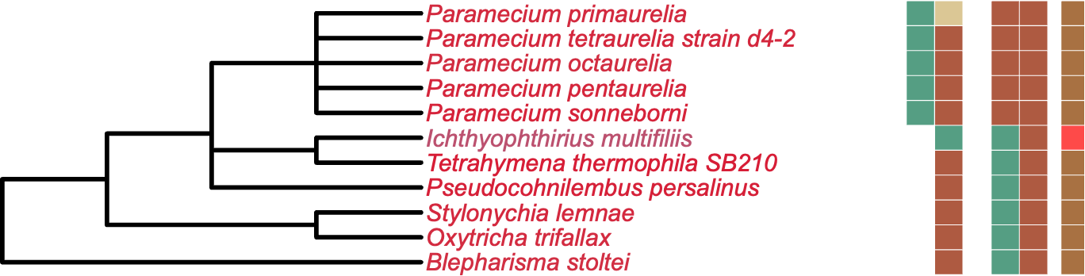
Figure 5
LST8
RICTOR
RAPTOR
SIN1
TOR
Stramenopiles
Alveolata
Rhizaria

Slide 6
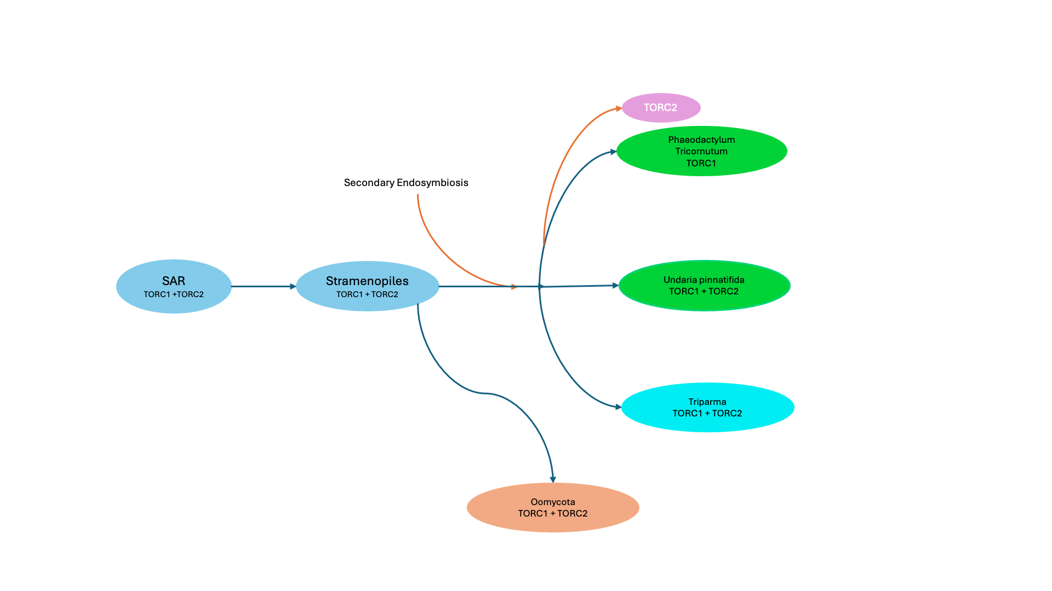
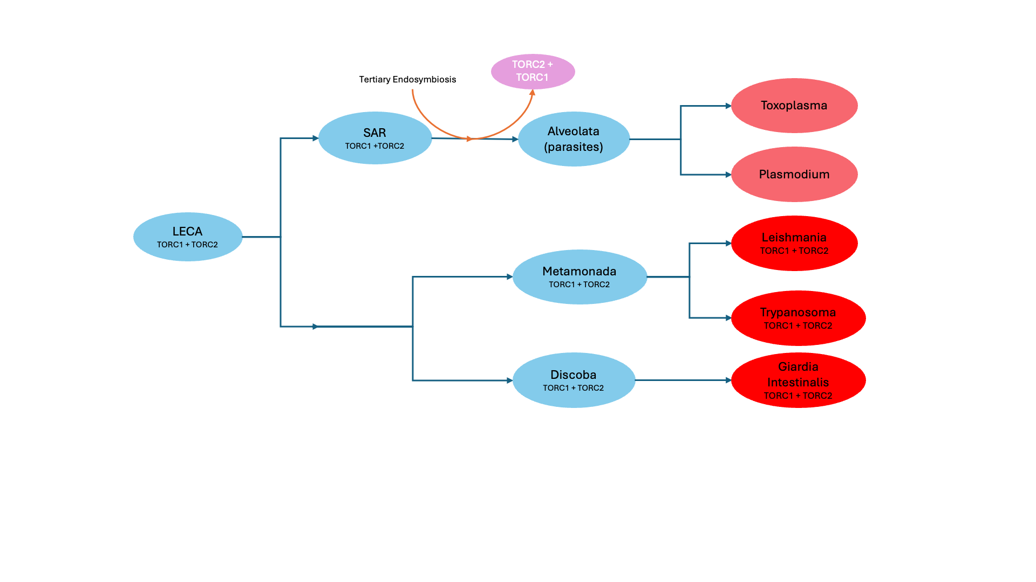
LECA
TORC1 +TORC2
Primary Endosymbiosis
TORC2
Archaeplastida
TORC1
Chlorophyta
TORC1
Streptophyta
TORC1
Rhodophyta
TORC1

Slide 7
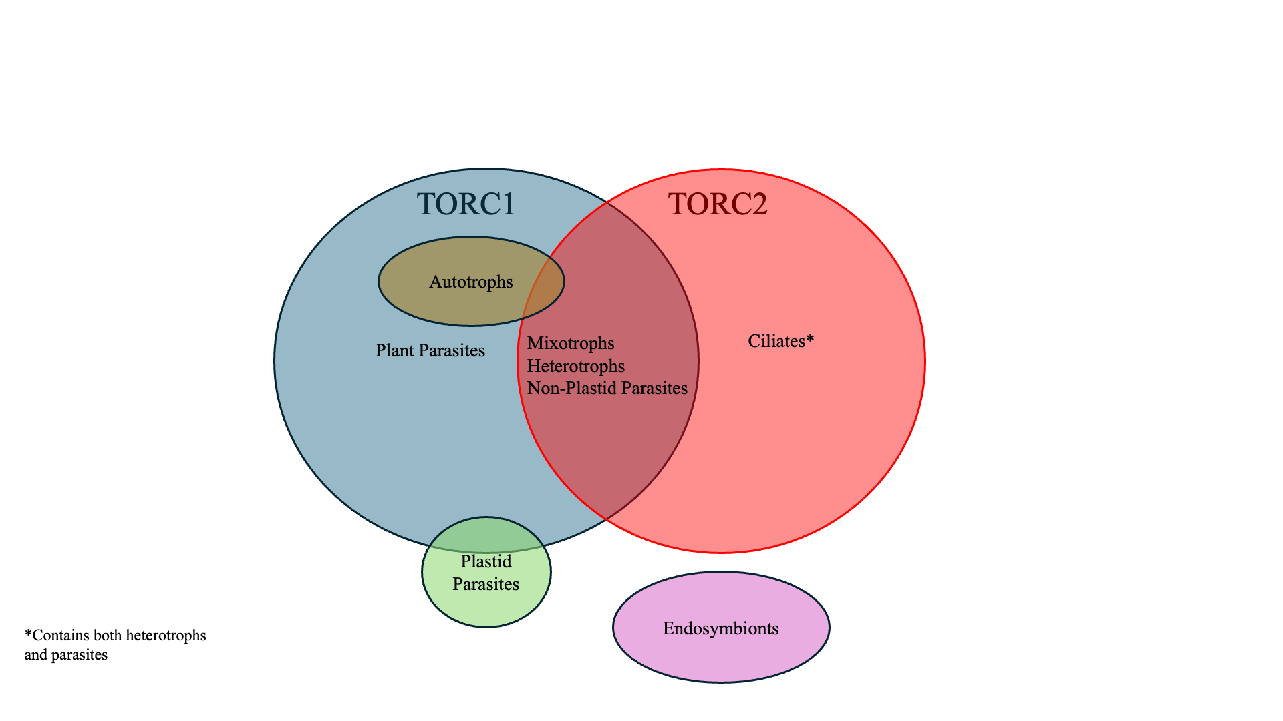

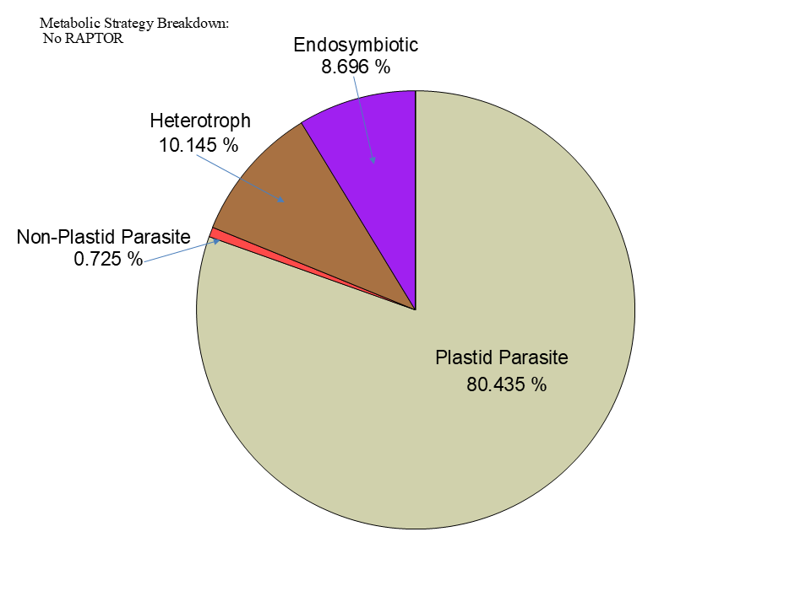

Figure 6

Slide 8
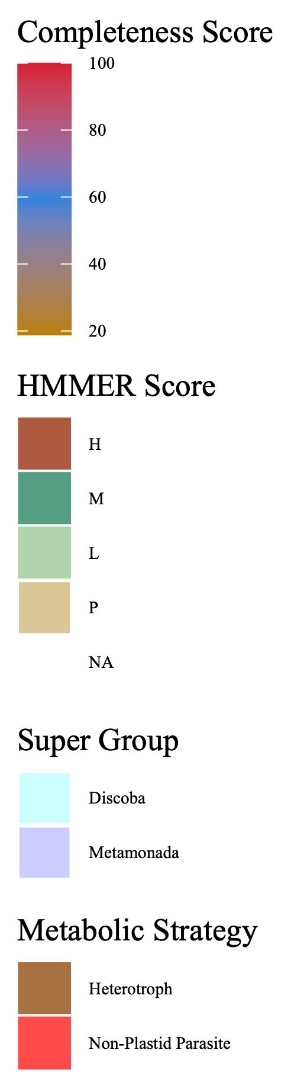
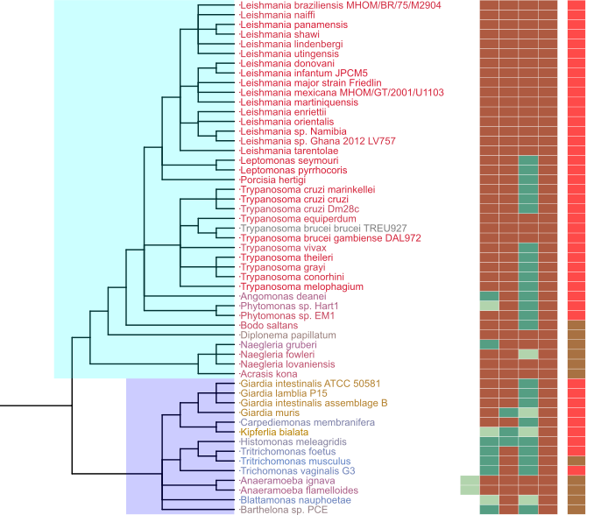
Figure 7
Metabolic Strategy
SIN1
RICTOR
RAPTOR
LST8
TOR
Discoba
TORC2
Archaeplastida
TORC1
LECA
TORC1
TORC2
Excavates
TORC1
TORC2
Discoba
TORC1
TORC2
Metamonada
Metamonada
TORC1
TORC2

Slide 9
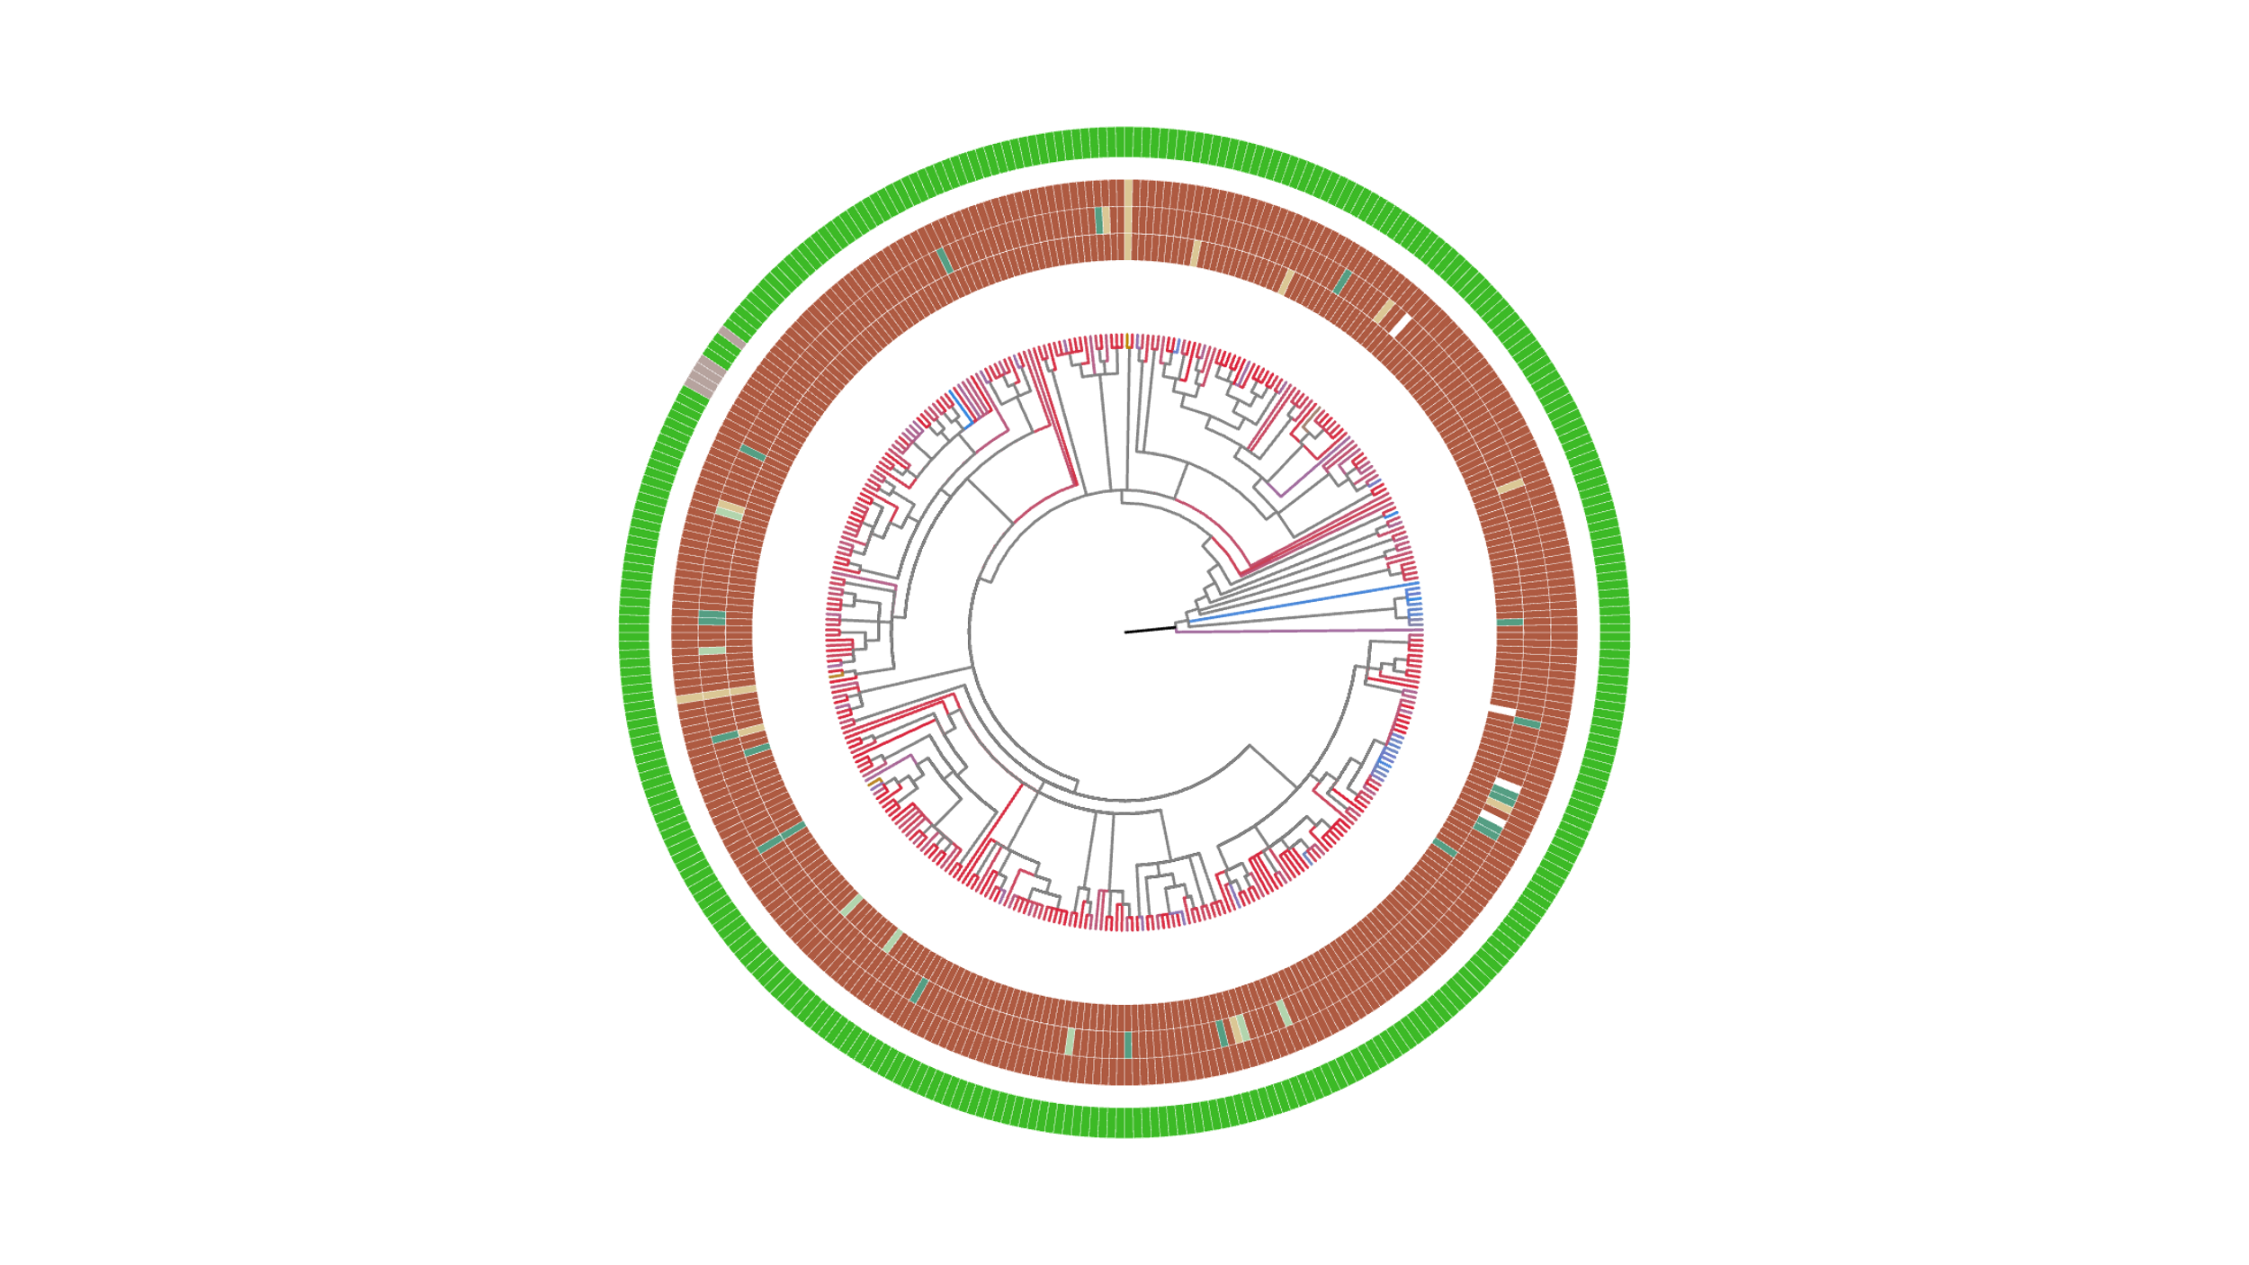
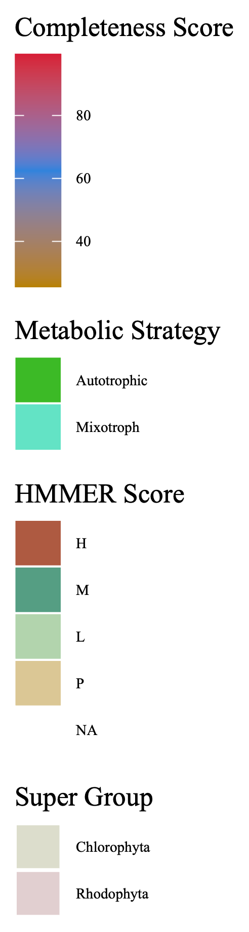
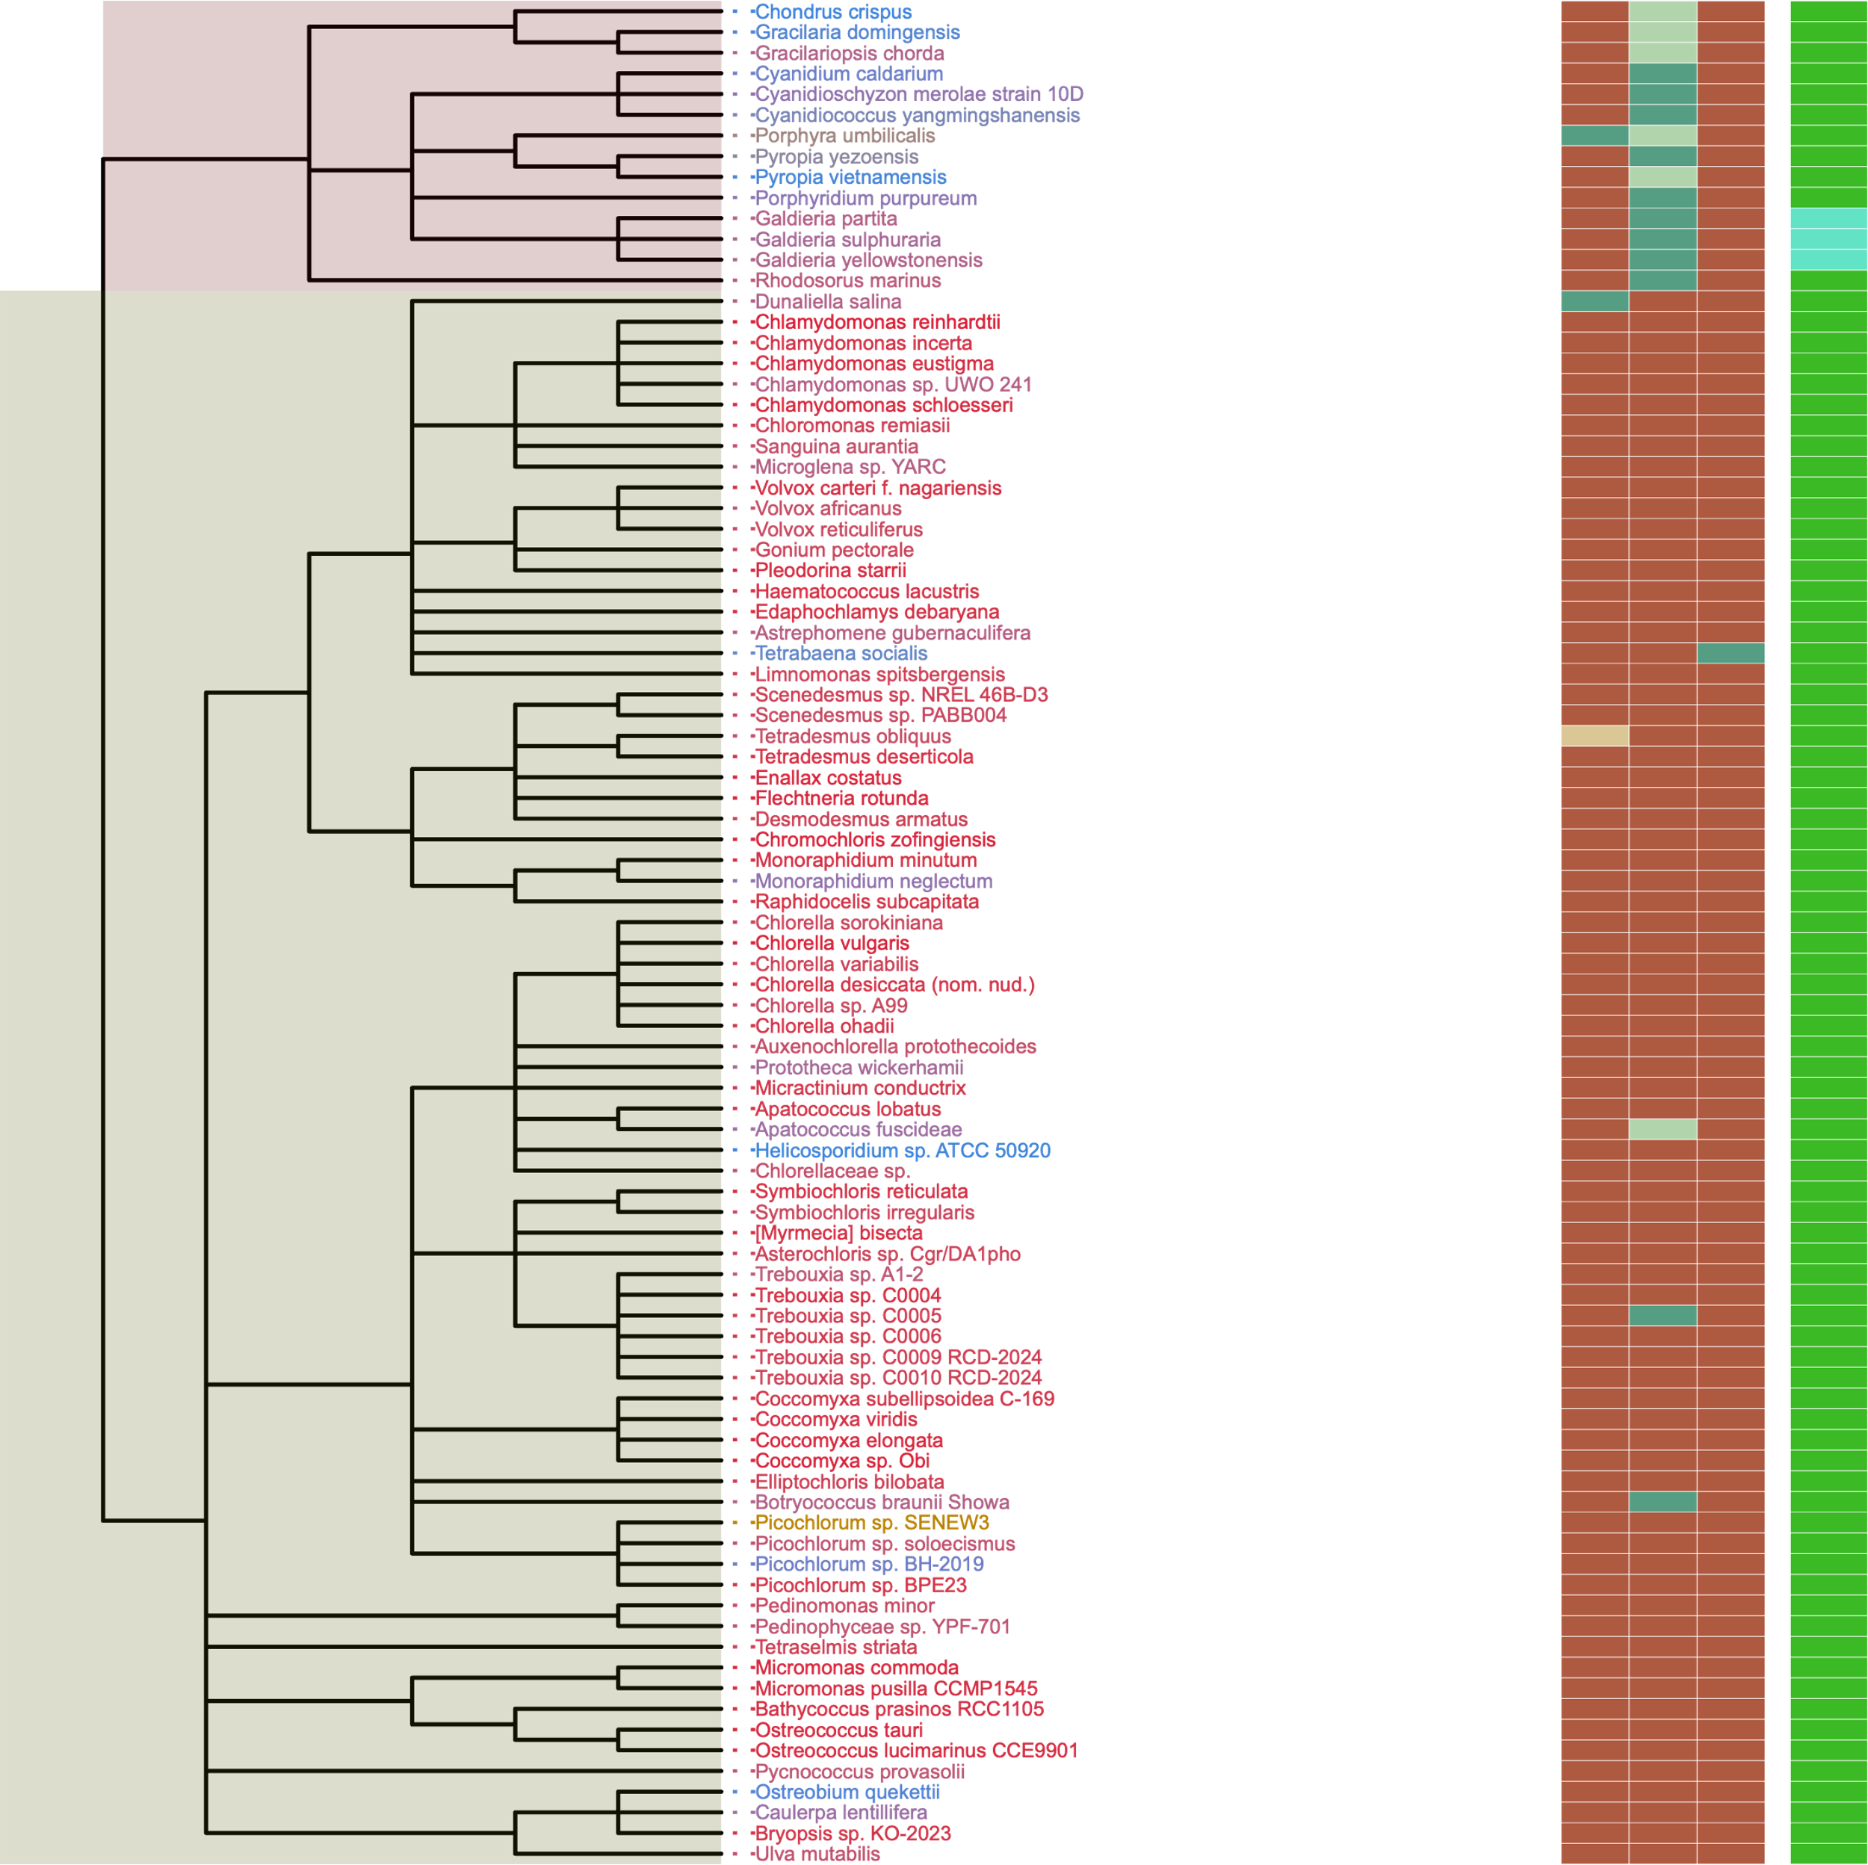
Figure 7
Metabolic Strategy
SIN1
RICTOR
RAPTOR
LST8
TOR
Streptophyta
Rhodophyta
Chlorophyta
Rhodophyta
TORC1
TORC2
Archaeplastida
Chlorophyta
TORC1
TORC1
Streptophyta
LECA
TORC1
TORC1
TORC2
Excavates,SAR,Opisthokonta,etc
TORC1
TORC2

Slide 10
ARCHIVED BELOW

Slide 11
Streptophyta
Metabolic Strategy
SIN1
RICTOR
RAPTOR
LST8
TOR
Rhodophyta
Rhodophyta
TORC2
Chlorophyta
Archaeplastida
Chlorophyta
TORC1
Streptophyta
LECA
TORC1
TORC2
Excavates,SAR,Opisthokonta
TORC1
TORC2

Slide 12
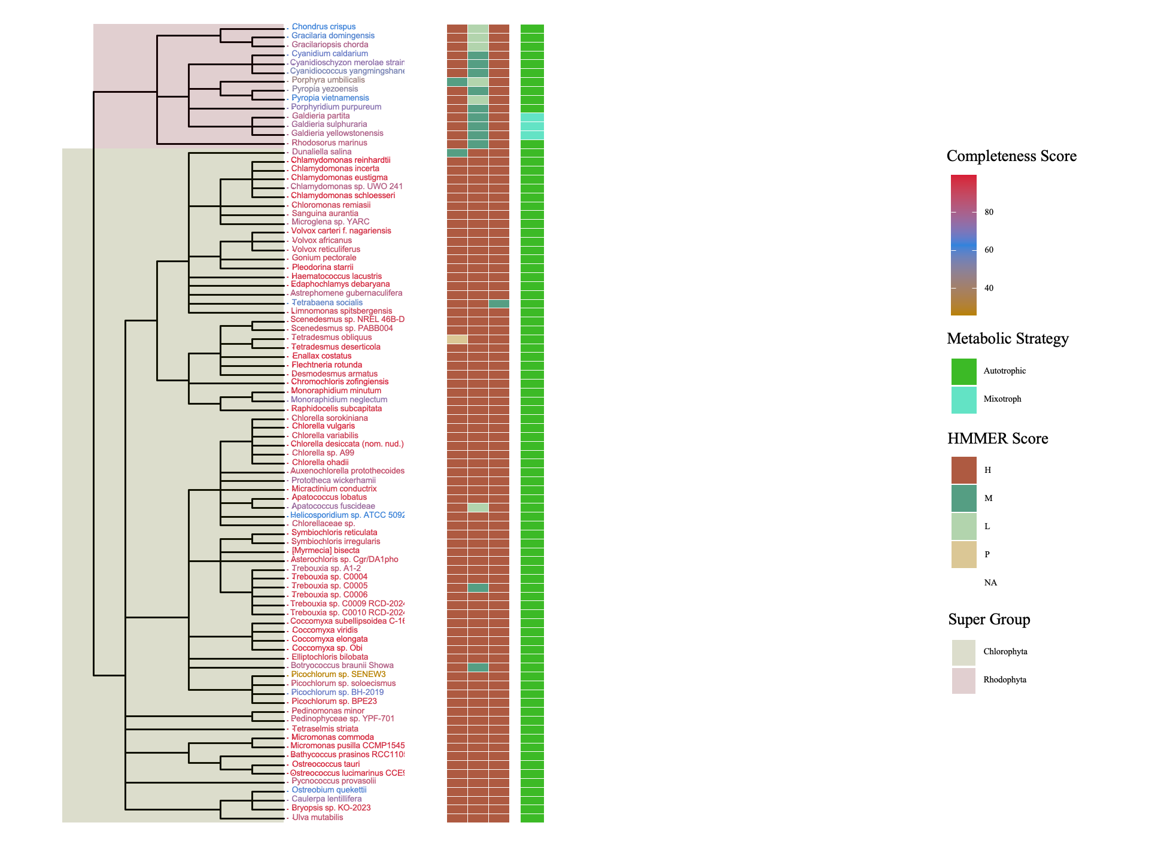
Figure 7
Metabolic Strategy
Metabolic Strategy
SIN1
RICTOR
LST8
RAPTOR
SIN1
TOR
RICTOR
RAPTOR
LST8
TOR
Rhodophyta
Discoba
Chlorophyta
Metamonada

Slide 13
Rhodophyta
TORC1
TORC2
Archaeplastida
Chlorophyta
TORC1
TORC1
Streptophyta
LECA
TORC1
TORC1
TORC2
Excavates,SAR,Opisthokonta,etc
TORC1
TORC2

Slide 14
Figure 1
MSA
Phylogenetic Tree(s)
Final Images,
Pattern Loss Detection
Genome information from NCBI/JGI
BUSCO/HMMER/BLAST
Combined Dataframes
Graphs/Plots/Tables
Trophic Strategy from literature
SRA/DIAMOND

Slide 15
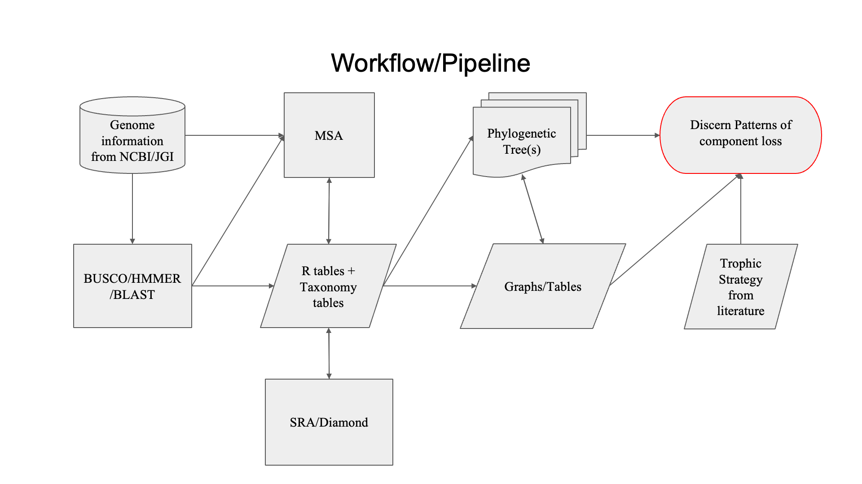
Figure 1

Slide 16
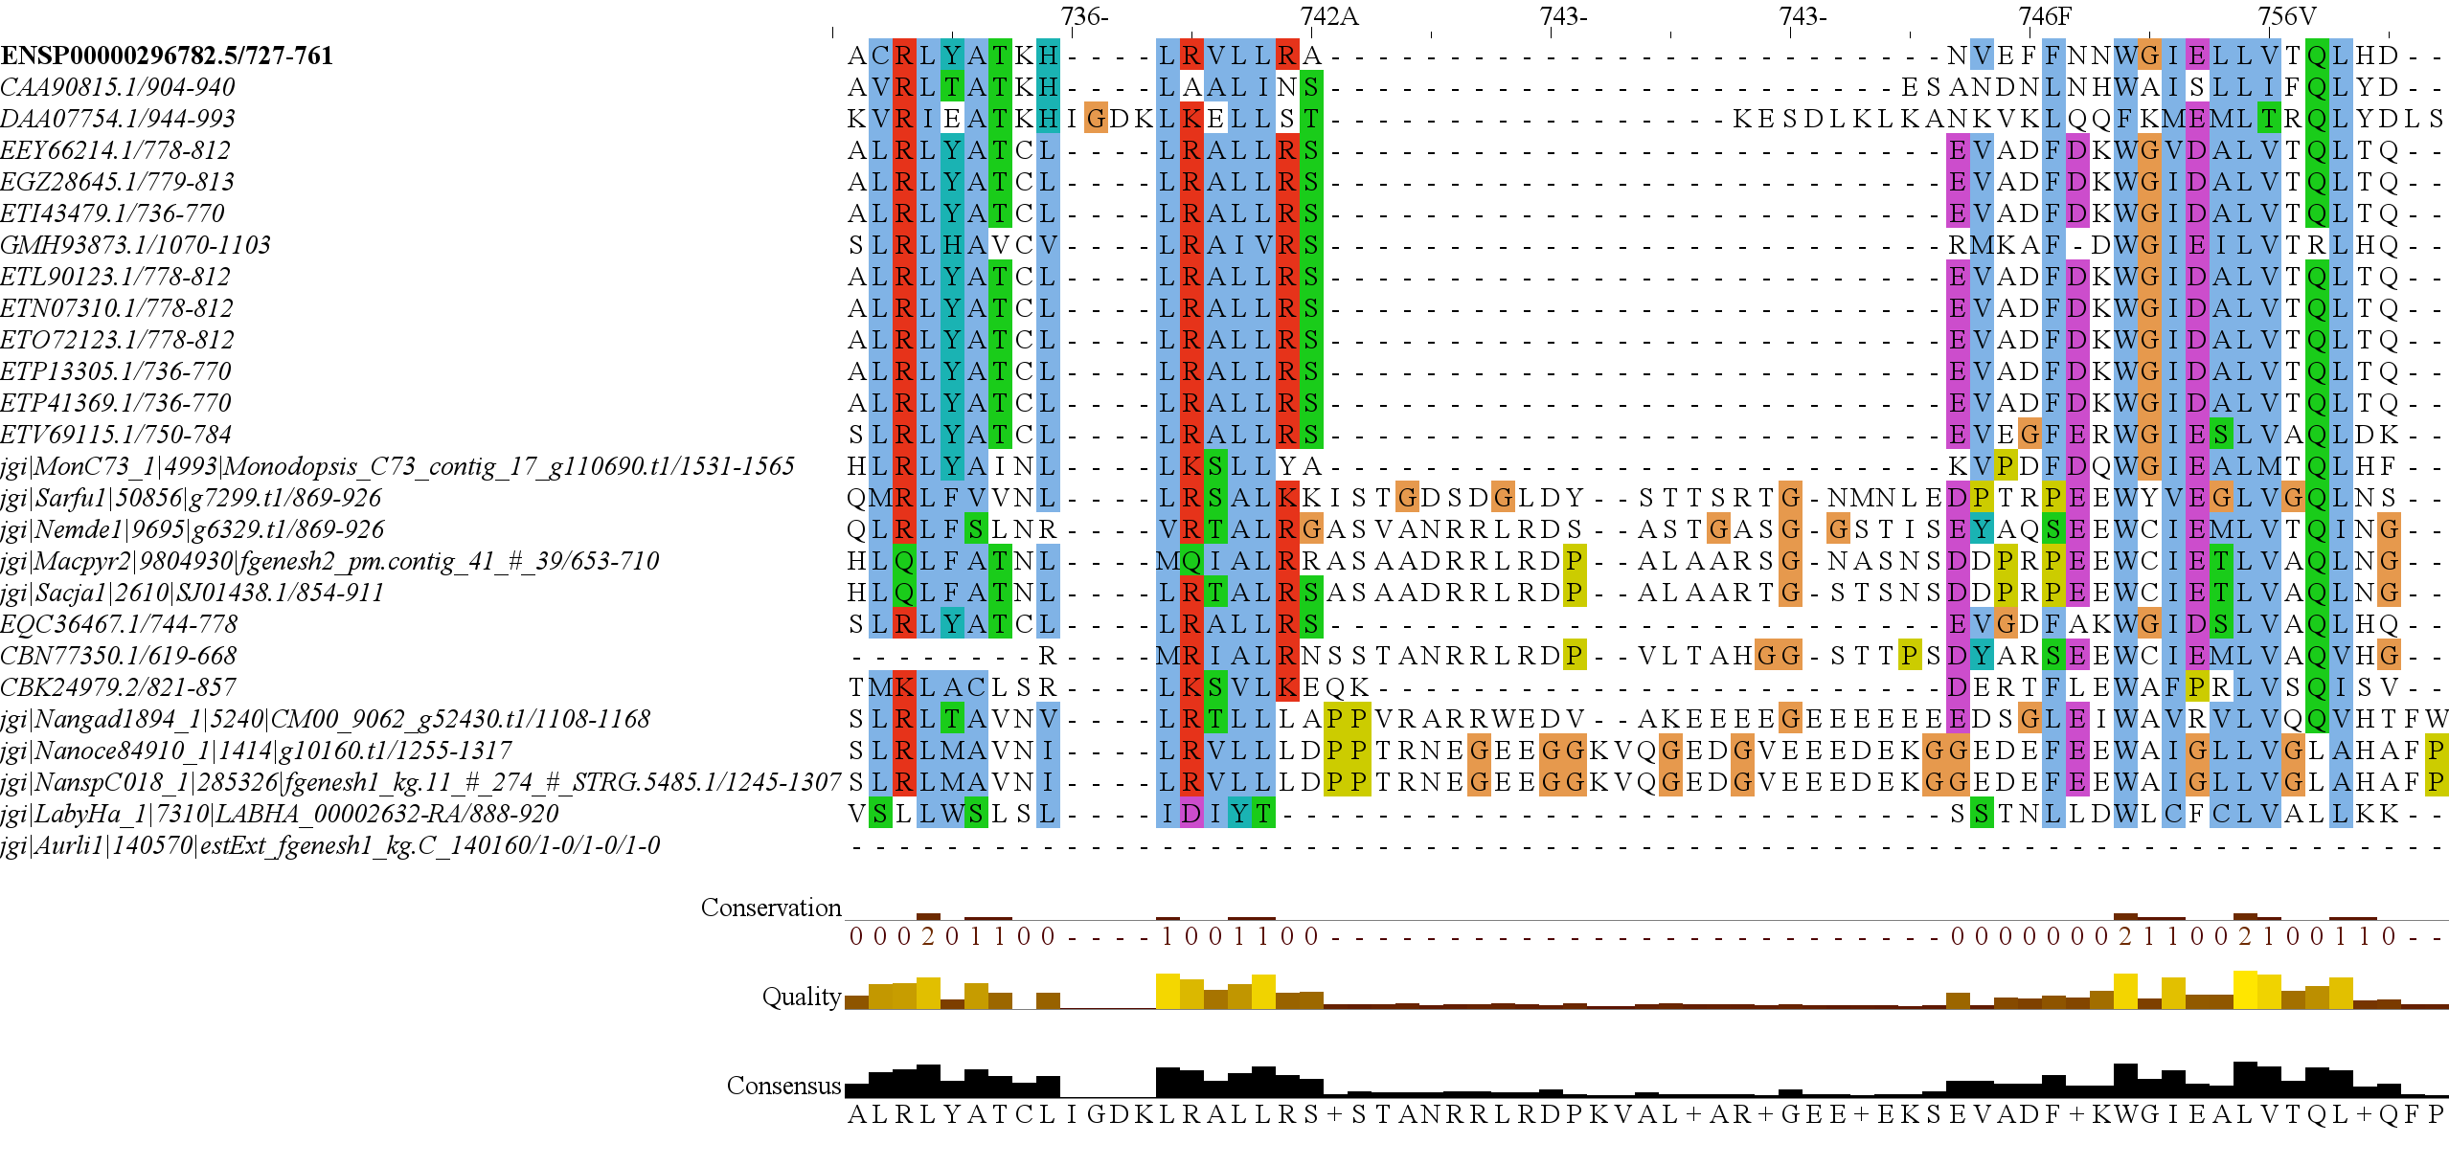
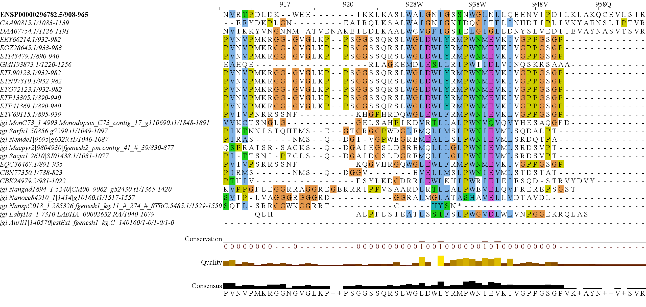
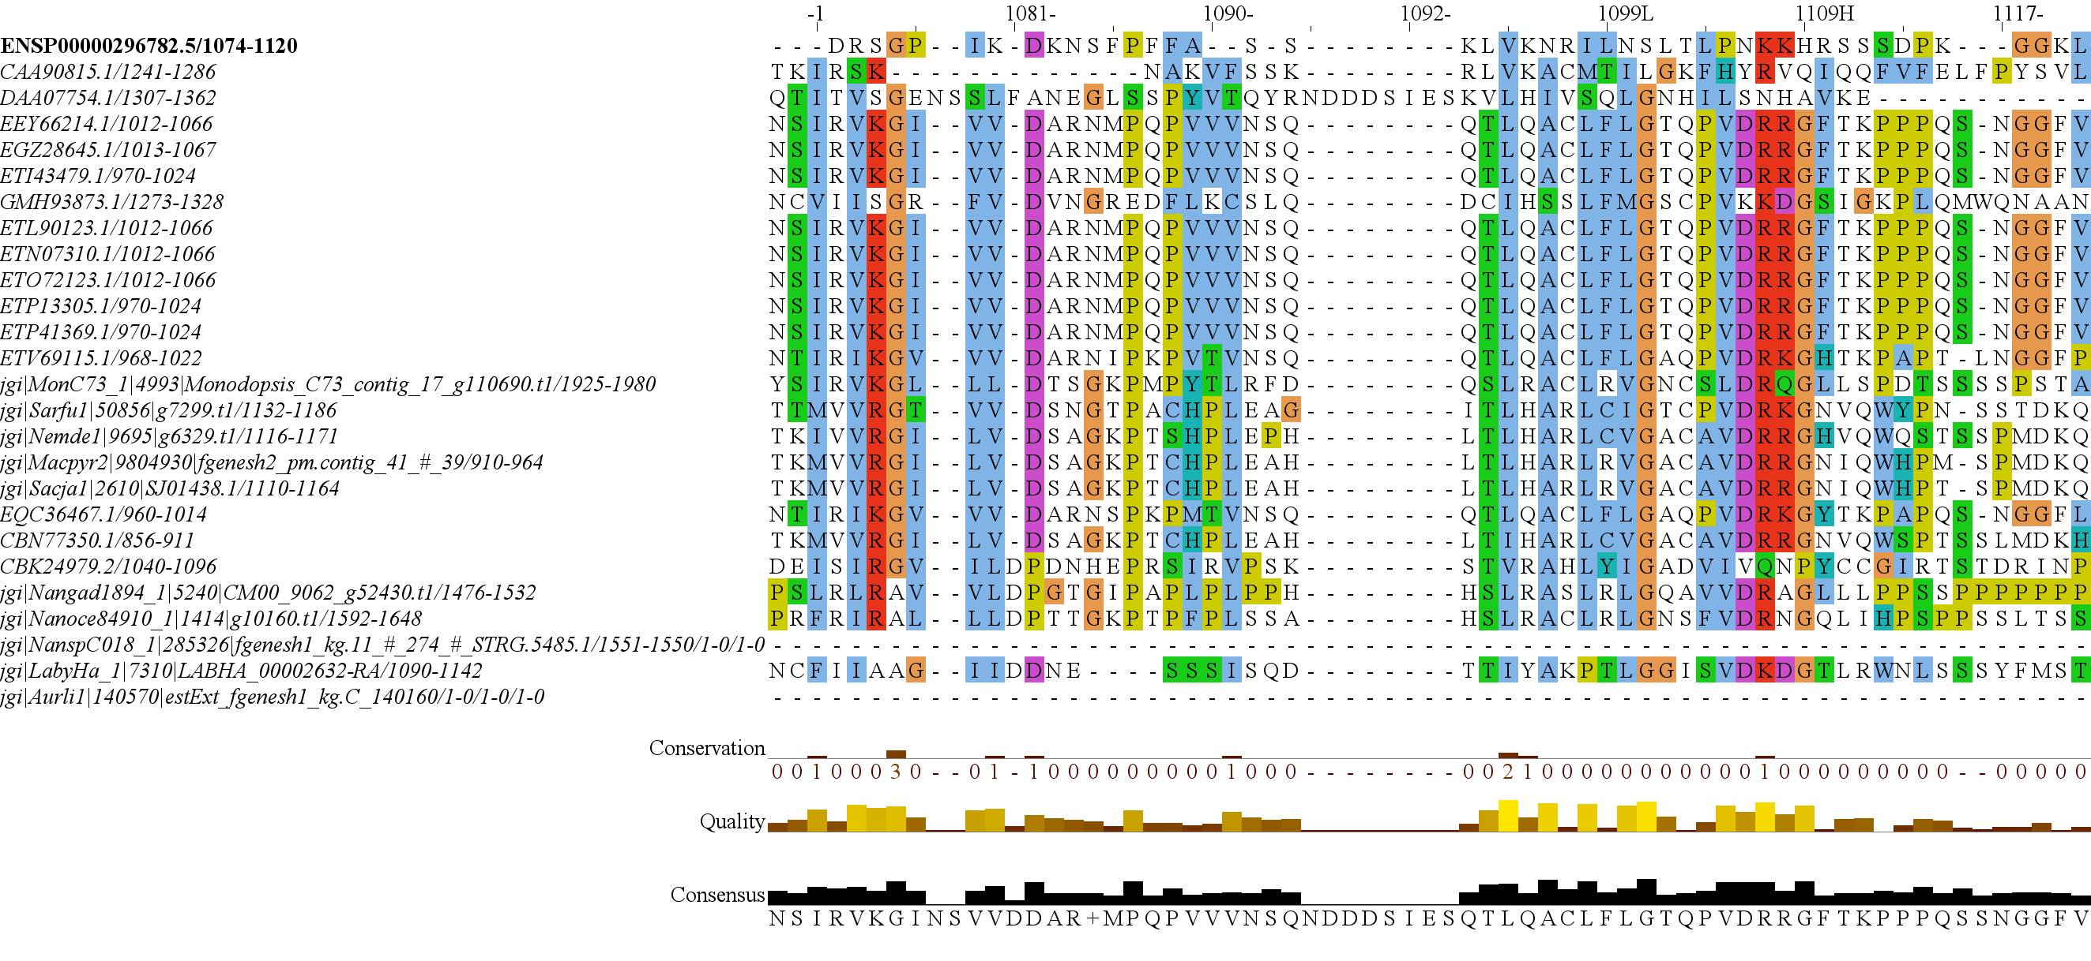
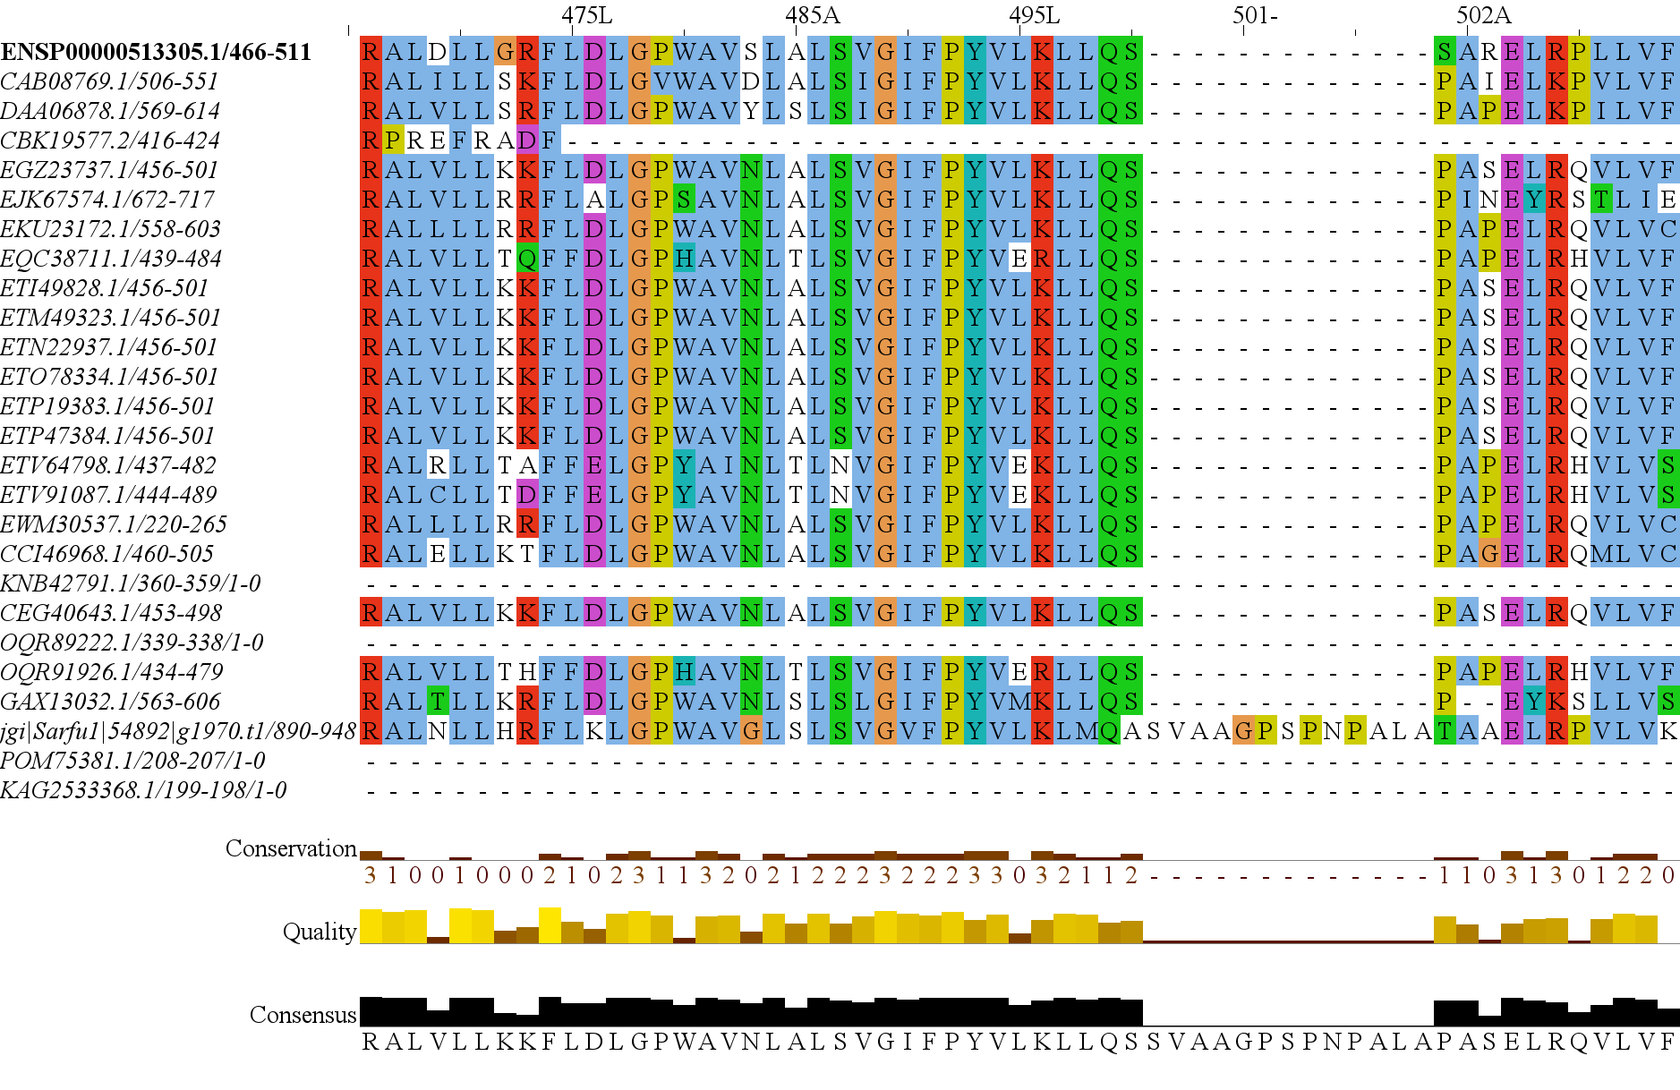
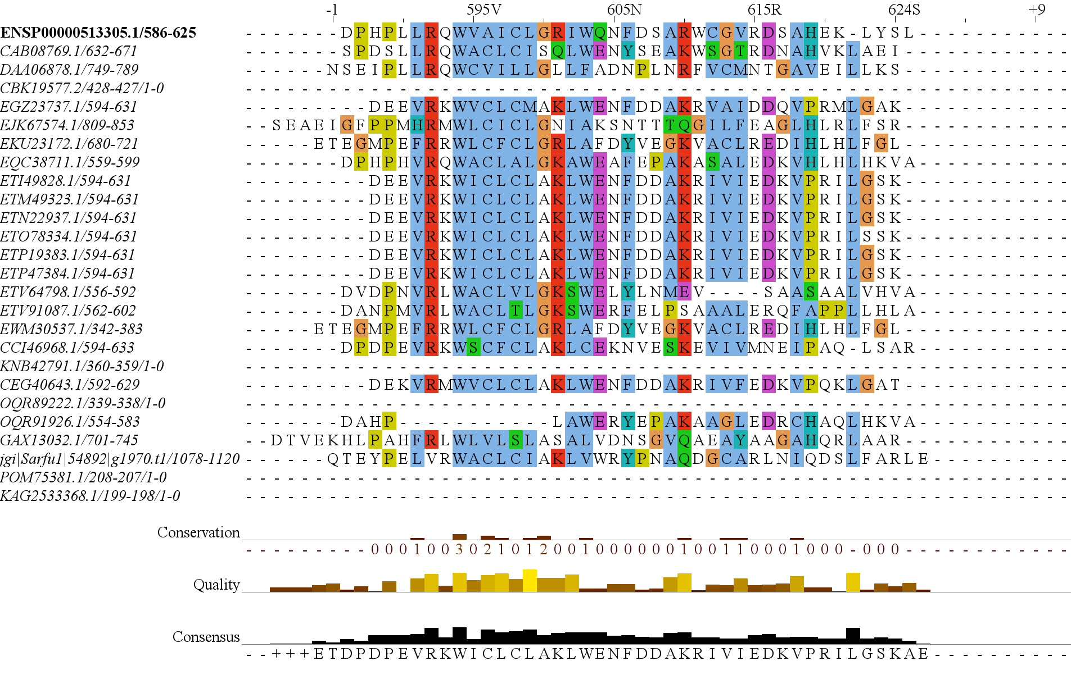
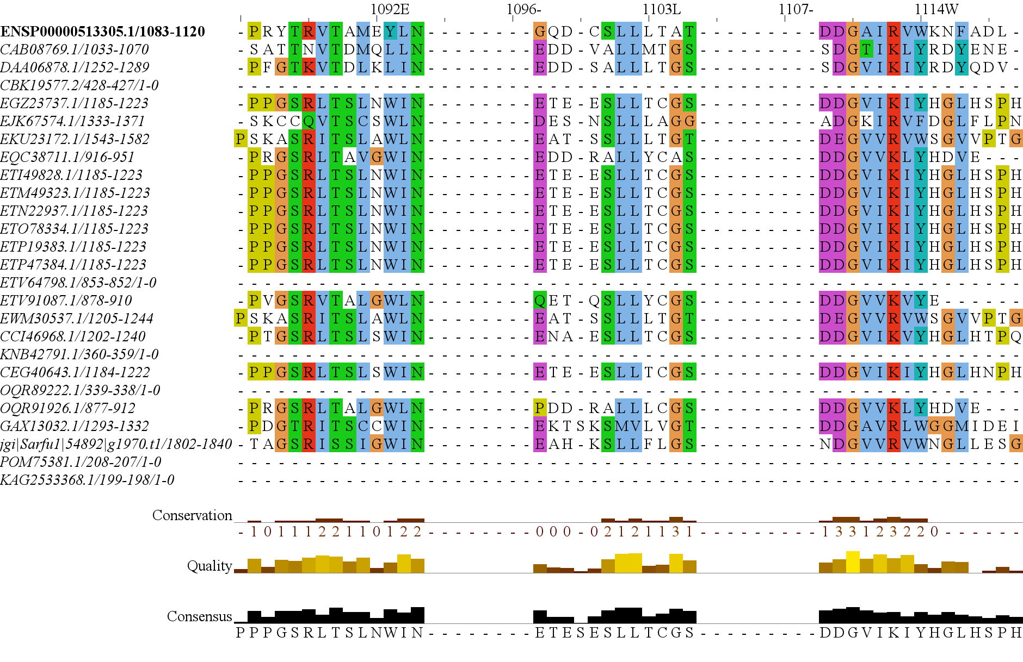
Figure 3
1
RasGEF
Domain5
1694
RICTORN
RICTORM
RICTOR Phosphorylation
Reference
High
Medium
Low
1
HEAT
ARM Repeats
1353
RAPTORN
ARM Repeats
WD-40 Repeats
Reference
High
Medium

Slide 17
Figure 3
1
1694
RICTORN
RICTORM
RasGEF
Domain5
RICTOR Phosphorylation
ARM Repeats
Reference
High
Medium
Low
1
1353
RAPTORN
ARM Repeats
HEAT
ARM Repeats
WD-40 Repeats
Reference
High
Medium

Slide 18
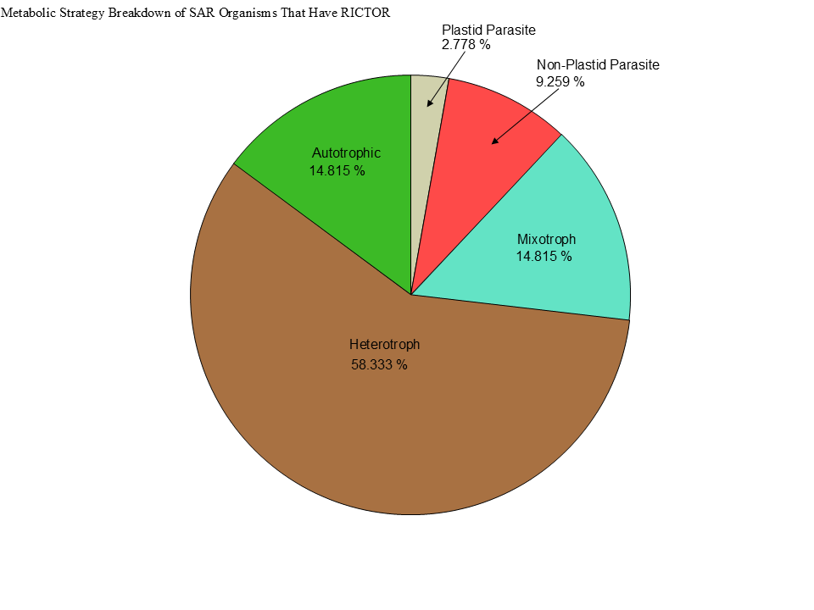
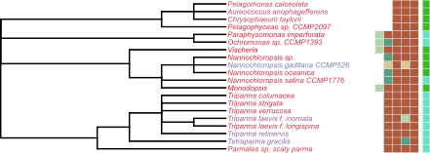
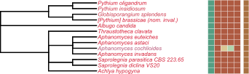
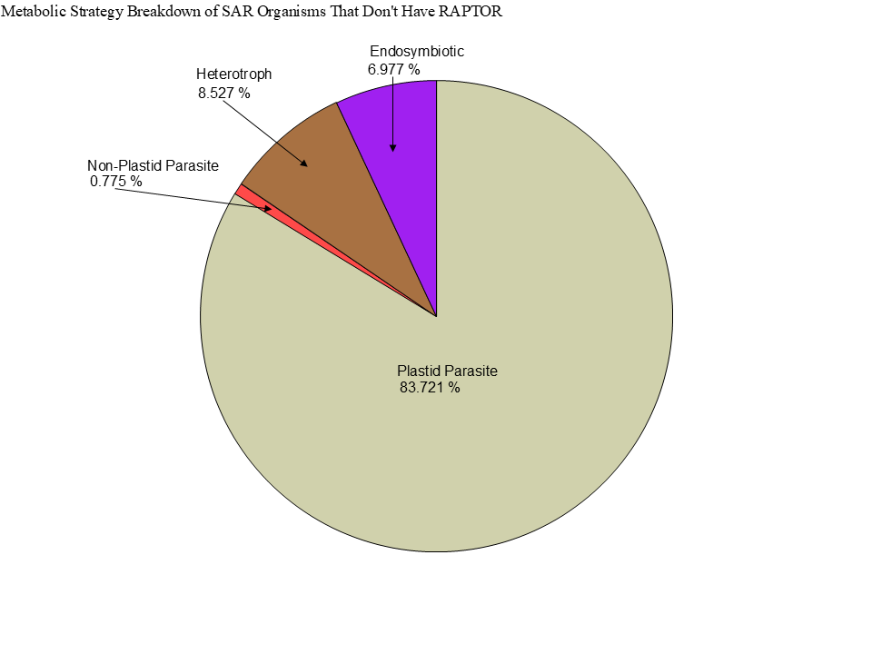
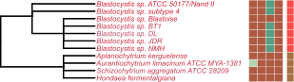



Metabolic Strategy
LST8
RICTOR
RAPTOR
SIN1
TOR
Stramenopiles
Alveolata
Rhizaria

Slide 20


Slide 21




Figure 3
TOR
LST8
RAPTOR
RICTOR
SIN1

Slide 22
Streptophyta
Secondary Endosymbiosis
Rhodophyta
Primary Endosymbiosis
TORC2
Chlorophyta
Chlorarachniales
TORC1 + TORC2
Rhizaria
TORC1 + TORC2
Primary Endosymbiosis
Archaeplastida
TORC1
LECA
TORC1 + TORC2
Paulinella Micropora
TORC1 + TORC2
SAR
TORC1 +TORC2
Secondary Endosymbiosis
TORC2
Stramenopiles TORC1 + TORC2
Brown Algae
TORC1
Secondary Endosymbiosis
Excavates
TORC1 +TORC2
Tertiary Endosymbiosis
TORC2 + TORC1
Eulena Gracilis
TORC1 + TORC2
Alveolata

Slide 23


Figure 7
Metabolic Strategy
SIN1
RICTOR
RAPTOR
LST8
TOR
Discoba
Metamonada

Slide 24



Metabolic Strategy
Streptophyta
SIN1
RICTOR
RAPTOR
LST8
TOR
Rhodophyta
Chlorophyta

Slide 25



Slide 26





Figure 6

Slide 27


Figure 6

Slide 28



Figure 6

Slide 29
Figure 5

Slide 30
Workflow/Pipeline
NCBI/JGI Genomic Information
MSA
Phylogenetic Tree(s)
Results/TOR Complex Patterns
BUSCO/HMMER/BLAST
R Tables & Taxonomy Tables
Graphs/Data Table
SRA /Diamond Alignment
Notes:
We need to add a start point. Have something that asks the question; what organisms have TORC2 Components and TORC1 Components?

Slide 31
SARs Gain of Plastids:
Losses of TOR Complexes
Rhodophyta Endosymbiosis
Phaeodactylum tricornutum
TORC2 Lost
Macrocystis pyrifera
Stramenopila
Nannochloropsis gaditana
Phytophthora sojae
Expected Heterotrophic Ancestor
TORC1 & TORC2 Present
Stramenopile Endosymbiosis
Polarella glaciallis
Vitrella Brassicaformis
Alveolata
Plasmodium falciparum
Tetrahymena thermophila
Alpha-Cyanobacteria Endosymbiosis
Photoautorophy Loss
Paulinella micropora
TORC1 and TORC2 Lost
Bigelowiella natans
TORC1 Lost
Rhizaria
Chlorophyta Endosymbiosis
Plasmodiophora brassicae

Slide 32
Figure 4

Slide 33


Slide 34


Figure 4

Slide 35
Phylo Trees
HMMER
ClustalO
NCBI/JGI
BLAST
Final Images
Patterns of Loss
Dataframe
BUSCO
DIAMOND
Graphs
Metabolism
Literature
Notes:
We need to add a start point. Have something that asks the question; what organisms have TORC2 Components and TORC1 Components?

Slide 36
Simplified Excavata Gain of Plastids
Chlorophyta Endosymbiosis
Euglenophyceae
Discoba
Kinetoplastea
Eutetramitia, etc.
Expected Heterotrophic Ancestor
TORC1 & TORC2 Present
Metamonada

Slide 37


Slide 38

Figure 1
Metamonada
Opisthokonta
Amoebozoa
Discoba
Rhizaria
Streptophyta
Alveolata
Stramenopila
Rhodophyta
Chlorophyta

Slide 39




Figure 7

Slide 40




Slide 41
Figure 3

Slide 42




Slide 43


Slide 44


Slide 45


Slide 46

Figure 3
TOR
LST8
RAPTOR
RICTOR
SIN1

Slide 47








Figure 2

Slide 48
Metabolic Strategy
LST8
RICTOR
RAPTOR
SIN1
TOR
Stramenopiles
Alveolata
Rhizaria

